Slide 1
Therapeutic strategies: oncolytic virus therapy
Last updated: November 2020

Slide 2
Introduction
Oncolytic viruses may have the potential to kill cancer cells while sparing healthy cells¹
Interest in utilizing oncolytic viruses for cancer therapy has spanned more than 70 years and appears to be reaching fruition, with the first oncolytic viruses now licensed by the FDA and EMA^{2–4}
Currently available data suggest that oncolytic viruses may cause long-lasting tumor regression⁵ through various mechanisms, including direct tumor lysis, by delivering a payload of immunotherapy and stimulating antitumor immune responses^{5,6}
A number of different tactics with oncolytic viruses are under investigation to optimize potential outcomes with this novel treatment strategy
1. Fountzilas C, et al. Oncotarget 2017;8(60):102617–39; 2. Pack GT. AMA Arch Derm Syphilol 1950;62(5):694–5; 3. Talimogene laherparepvec (IMLYGIC) US Prescribing Information, October 2015 (Accessed August 2020); 4. Talimogene laherparepvec (IMLYGIC) EU Summary of Product Characteristics, August 2019 (Accessed August 2020); 5. Conry RM, et al. Hum Vaccin Immunother 2018;14(4):839–46; 6. Kaufmann HL, et al. Nat Rev Drug Discov 2015;14(9):642–62.

Slide 3
Oncolytic viruses: rationale

Slide 4
Oncolytic viruses are a promising type of immunotherapy in the oncology landscape
Chemotherapy and radiotherapy
Targeted therapies
Immunotherapies and oncolytic viruses

Slide 5
The rationale for oncolytic virus therapy is based on multiple potential benefits
Oncolytic viruses may have the potential to selectively target cancer cells while sparing healthy cells^{1,2}
By genetically modifying viruses, oncolytic virus therapy may be tailored to the individual’s tumor type and driver mutations^{3–5}
Oncolytic viruses may also exhibit synergistic interactions with other cancer treatments^{1–10}
This represents a new type of therapy that might minimize additive adverse events when combined with currently available therapies^{1,5,7}
Oncolytic viruses act through alternative cell killing mechanisms that might overcome resistance to currently available therapies¹
Selective replication in cancer cells
Potential to tailor therapy
Synergistic activity with other treatments
Minimization of additive adverse events
Overcoming resistance to other treatments
1. Marchini A, et al. Virol J 2015;12:6; 2. Fountzilas C, et al. Oncotarget 2017;8(60):102617–39; 3. Kaufmann HL, et al. Nat Rev Drug Discov 2015;14(9):642–62; 4. Russell SJ, et al. Nat Biotechnol 2012;30(7):658–70; 5. Maroun J, et al. Future Virol 2017;12(4):193–213; 6. Martin NT, Bell JC. Mol Ther 2018;26(6):1414–22; 7. Hemminki O, et al. J Hematol Oncol 2020;13(1):84; 8. Jhawar SR, et al. Front Oncol 2017;7:202; 9. Khalil DN, et al. Nat Rev Clin Oncol 2016;13(5):273–90; 10. Kon T, et al. TCR 2012;1(1):6–14.

Slide 6
Oncolytic viruses: mechanism of action

Slide 7
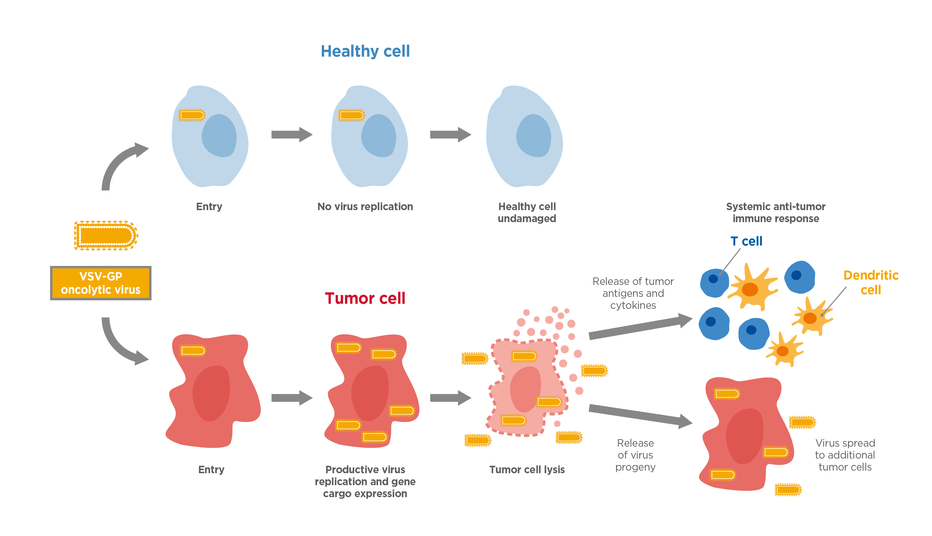
Oncolytic viruses might have the potential to selectively kill cancer cells
Oncolytic viruses are engineered or native viral strains that may have the potential to infect and kill cancer cells while sparing their normal counterparts¹
Oncolytic viruses exhibit a natural tropism (preference) for tissue types based on the tumor cell characteristics, including²
Selected surface receptors
Aberrant signaling pathways
The hypoxic tumor environment³
Non-productive viral replication
Healthy cell protected
Systemic anti-tumor immune response
Productive viral replication
Tumor cell killing
Figure adapted from Ungerechts et al. 2016⁴ and Davola and Mossman, 2019.⁵
1. Fountzilas C, et al. Oncotarget 2017;8(60):102617–39; 2. Kaufmann HL, et al. Nat Rev Drug Discov 2015;14(9):642–62; 3. Jhawar SR, et al. Front Oncol 2017;7:202; 4. Ungerechts G, et al. Mol Ther Methods Clin Dev 2016;3:16018; 5. Davola ME, Mossman KL. OncoImmunology;8(6):e1581528.

Slide 8
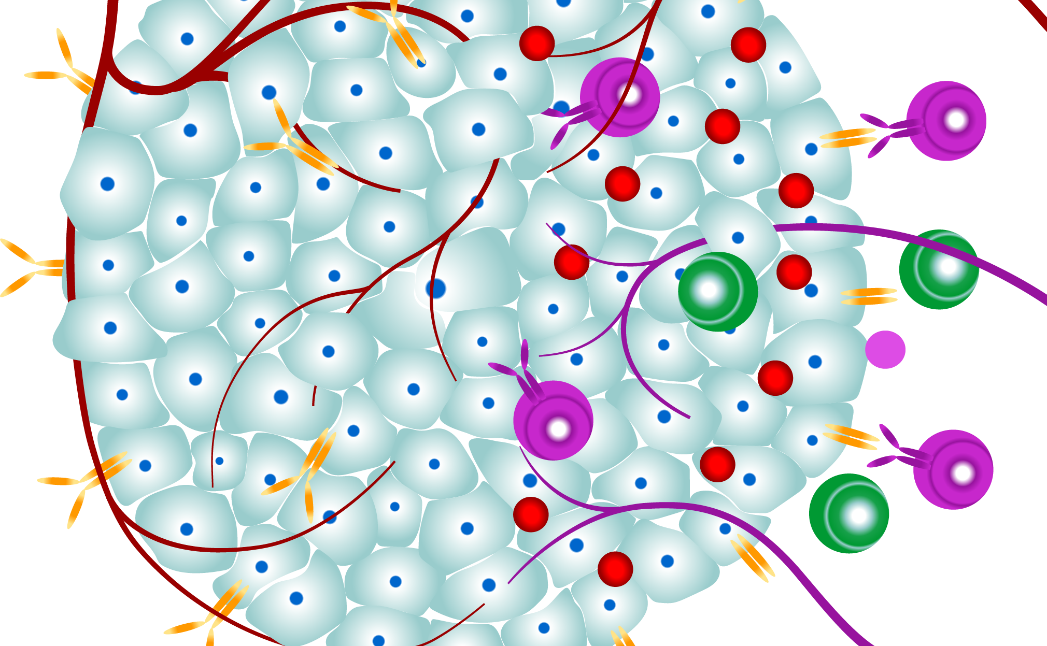
Oncolytic viruses act through multiple mechanisms
Tumor cell lysis and immunogenic cell death
Oncolytic viruses selectively replicate in cancer cells, resulting in a direct lytic effect or immunogenic cell death¹
Induction of systemic immunity
Oncolytic viruses induce systemic antitumor immunity when PAMPs and tumor antigens are released from the virus-affected cells¹
Disruption of the TME
By disrupting the TME, oncolytic viruses can help prevent the tumor cells from: escaping growth suppressors, invading, metastasizing, resisting apoptosis and stimulating angiogenesis^{1,2}
PAMPs, pathogen-associated molecular patterns; TME, tumor microenvironment.
1. Kaufmann HL, et al. Nat Rev Drug Discov 2015;14(9):642–62; 2. Wang M, et al. J Cancer 2017;8:761–73.

Slide 9
Oncolytic viruses: therapeutic considerations

Slide 10
A range of factors should be considered when using oncolytic viruses therapeutically
Therapeutic potential depends on the effective dose and tropism of the oncolytic virus, and the susceptibility of the tumor cell to the different forms of cell death¹
Tropism
Potential pathogenicity
Druggability
Viral genome stability
1. Kaufmann HL, et al. Nat Rev Drug Discov 2015;14(9):642–62.

Slide 11
A range of factors should be considered when using oncolytic viruses therapeutically
Tropism
Although oncolytic viruses preferentially infect tumor cells, there remains a low risk of viral transmission. The pathogenic potential of an oncolytic virus depends on the composition of intrinsic virulence factors of the specific virus¹
Potential pathogenicity
Druggability
Viral genome stability
1. Kaufmann HL, et al. Nat Rev Drug Discov 2015;14(9):642–62.

Slide 12
A range of factors should be considered when using oncolytic viruses therapeutically
Tropism
Potential pathogenicity
Oncolytic viruses have limited clinical efficacy as a single agent.¹ To increase therapeutic potential against tumor cells, some oncolytic viruses are now engineered as vectors to carry transgenes or being investigated in combination with immunotherapies²
Druggability
Viral genome stability
1. Fountzilas C, et al. Oncotarget 2017;8(60):102617–39; 2. Kaufmann HL, et al. Nat Rev Drug Discov 2015;14(9):642–62.

Slide 13
A range of factors should be considered when using oncolytic viruses therapeutically
Tropism
Potential pathogenicity
Engineered oncolytic viruses may exhibit genome instability, enabling them to boost diversity when needed. When used therapeutically, oncolytic viruses with stable viral genomes are preferred in order to conserve their therapeutic profiles^{1,2}
Druggability
Viral genome stability
1. Kaufman HL, Bommareddy PK. J Immunother Cancer 2019;7(1):26; 2. McCarthy C, et al. Cancers 2019;11(5):65.

Slide 14
Oncolytic viruses: natural and engineered tropism

Slide 15
Therapeutic oncolytic viruses are often modified versions of naturally occurring viruses
Most clinically relevant oncolytic viruses use attenuated strains or naturally occurring viruses with low pathogenic potential in healthy tissue¹
Methods of attenuation include mutation or removal of non-essential genes encoding virulence factors, such as those associated with inhibition of apoptosis or aberrant RAS signaling^{1–3}
Innovative approaches to minimize the pathogenic potential of otherwise powerful oncolytic viruses by the insertion of attenuating nucleic acids are currently under clinical investigation^{4,5}
e.g. insertion of the interferon β transgene into VSV enhances safety by preventing viral replication in healthy cells, as well as enhancing antitumor immune responses⁶
Example of VSV modification^{4,5}
Wild type VSV⁴
Type 1 interferon production is critical in normal host antiviral response to VSV infection
Modified VSV⁵
Replication in normal cells is compromised by interferon response
Virus proliferates only in tumor cells with defective or reduced interferon response
x
Insertion of interferon β reporter gene
✓
VSV, vesicular stomatitis virus.
1. Kaufmann HL, et al. Nat Rev Drug Discov 2015;14(9):642–62; 2. Russell SJ, et al. Nat Biotechnol 2012;30(7):658–70; 3. Maroun J, et al. Future Virol 2017;12(4):193–213; 4. Faul EJ, et al. Viruses 2009;1:832–51; 5. Buijs PRA, et al. Hum Vaccin Immunother 2015;11(7):1573–84; 6. Willmon CL, et al. Cancer Res 2009 69(19):7713–20.

Slide 16
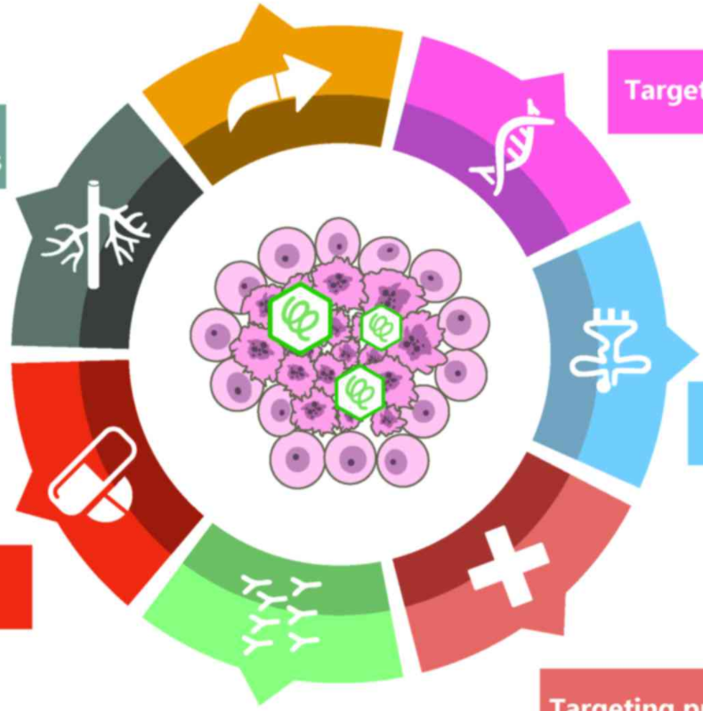
Oncolytic viruses can be modified to target specific cancer types
Oncolytic viruses propagate and infect cells by using many of the same host cell proteins and pathways that tumor cells use to proliferate, evade the immune system and metastasize¹
These oncogenic proteins help oncolytic viruses specifically target tumor cells that express the aberrant oncogenes¹
Virus genomes may be modified to enhance anti-tumor specificity,² e.g. the highly lytic measles virus has been retargeted from its native CD46 and SLAM receptors to tumor-selective CD38 or EGFR³
Genetically modified oncolytic viruses carrying therapeutic or immunomodulatory genes, e.g. IL-2 or GM-CSF, IFNγ or TNF have been shown to further improve antitumor immune responses^{1,4}
Oncolytic viruses can be engineered or selected for greater specificity or cytotoxicity through a number of mechanisms⁵
Targeting transduction
Targeting transcription
Genes expressing angiogenesis inhibitors
Targeting translation
Genes expressing prodrug-converting enzymes
Normal cell
Tumor cell
Virus
Targeting pro-apoptosis
Immunostimulatory genes
Figure adapted from Lin CZ et al. 2018.⁵ EGFR, epidermal growth factor receptor; IFNγ, interferon gamma; GM-CSF, granulocyte macrophage colony stimulating factor; IL, interleukin; TNF, tumor necrosis factor.
1. Jhawar SR, et al. Front Oncol 2017;7:202; 2. Russell SJ, et al. Nat Biotechnol 2012;30(7):658–70; 3. Nakamura T, et al. Nat Biotechnol 2005;23(2):209–14; 4. Vigil A, et al. Cancer Res 2007;67(17):8285–92; 5. Lin CZ, et al. Oncol Lett 2018;15(4):4053–60.

Slide 17
Viruses have specific cellular tropisms that determine which tissues are preferentially infected
Reovirus
Coxsackievirus
Newcastle disease virus
Parvovirus B19
Mumps virus
Myxoma virus
Seneca Valley virus
Viruses with a natural preference for cancer cells^{1–4}
Ras-transformed cells
e.g. myocardial tissue and other cells expressing CAR
e.g. gliomas, solid tumors
e.g. glioma and human erythroid progenitor cells
e.g. multiple myeloma, ovarian cancer
e.g. acute myeloid leukemia, melanoma
e.g. tumors of neuroendocrine origin
Adenovirus
HSV
Measles
Vaccinia virus
Viruses engineered or adapted to be cancer specific^{1–4}
e.g. bladder cancer, sarcomas and gliomas
e.g. melanomas, CRC and gliomas
e.g. solid tumors and hematologic malignancies
e.g. HCC
CAR, coxsackie and adenovirus receptor; CRC, colorectal cancer; HCC, hepatocellular carcinoma; HSV, herpes simplex virus.
1. Fountzilas C, et al. Oncotarget 2017;8(60):102617–39; 2. Russell SJ, et al. Nat Biotechnol 2012;30(7):658–70; 3. Melzer MK, et al. Biomedicines 2017;5(1):8; 4. Maroun J, et al. Future Virol 2017;12(4):193–213.

Slide 18
Oncolytic viruses could act additively or synergistically with other therapies
Immuno-therapy | Combinations of oncolytic viruses with ICIs could help suppress systemic tumor resistance to ICIs¹
 | An oncolytic virus modified to express cytokines (RANTES and IL-15) has been shown to enhance CAR-T therapy, whereby cytotoxic T cells are modified to target a surface antigen on tumor cells and help induce cell death²
 | Because oncolytic viruses can be cleared by the host’s MPS, depletion of MPS may help prevent viral clearance and prolong therapeutic efficacy of oncolytic viruses³
Angiogenesis inhibitors | Intratumoral RAMBO, an oncolytic virus expressing vasculostatin, suppresses bevacizumab-induced glioma invasion⁴
Targeted therapies | Therapeutic responses with HSV T-VEC are often limited, and BRAF/MEK inhibition is complicated by drug resistance. However, combination of T-VEC and the MEK inhibitor trametinib results in delayed melanoma tumor growth and improved survival in vivo.⁵ Inclusion of the TRAIL gene into Newcastle disease virus, an oncolytic RNA virus, has increased apoptosis levels in infected cells, as well as enhancing the antitumor immune response⁶
Cytotoxic chemotherapy | Oncolytic viruses may have additive or synergistic effects with conventional therapy, including chemotherapy and radiotherapy, which have recently been recognized to have potential immunomodulatory actions^{6,7}
Radiotherapy | Oncolytic viruses engineered to interfere with DNA repair following irradiation leads to significant antitumor efficacy⁸ and, in turn, ionizing radiation appears to enhance viral replication.⁹ Examples include combination treatment with radiation and VSV, resulting in synergistic growth suppression in HNSCC tumor models;¹⁰ VSV M protein, which has been shown to enhance radiation-induced apoptosis;¹¹ and, in early phase clinical trials, adenovirus appears to improve radiotherapy efficacy with no overlap in toxicity¹²
Anticancer vaccines | Combining the peptide/protein technology of therapeutic anticancer vaccines with oncolytic viruses aims to generate an anticancer immune response while minimizing side effects¹³
CAR-T, chimeric antigen receptor T cell; HNSCC, head and neck squamous cell carcinoma; HSV, herpes simplex virus; ICI, immune checkpoint inhibitor; IL-15, interleukin 15; M protein, matrix protein; MPS, mononuclear phagocytic system; RAMBO, rapid antiangiogenesis mediated by Oncolytic virus; RANTES, regulated upon activation, normal T cell expressed and secreted; T-VEC, talimogene laherparepvec; VSV, vesicular stomatitis virus.
1. Lawler SE, et al. JAMA Oncol 2017;3(6):841–49; 2. Martin NT, Bell JC. Mol Ther 2018;26(6):1414–22; 3. Russell SJ, et al. Nat Biotechnol 2012;30(7):658–70; 4. Tomita Y, et al. Mol Cancer Ther 2019;18(8):1418–29; 5. Bommareddy PK, et al. Sci Transl Med 2018;10(471):eaau0417; 6. Bai F-L, et al. Cancer Biol Ther 2014;15(9):1226–38; 7. Hemminki O, et al. J Hematol Oncol 2020;13(1):84; 8. Kon T, et al. TCR 2012; 1(1):6–14; 9. Chung S-M, et al. Gene Ther 2002;9(1):75-80; 10. Alajez NM, et al. Cancer Cell Int 2012;12:27; 11. Du X-B, et al. Apoptosis 2008;13(10):1205–14; 12. O’Cathail SM, et al. Front Oncol. 2017;7:153; 13. Boehringer Ingelheim. Data on file.

Slide 19
Challenges of oncolytic virus therapy in clinical practice

Slide 20
Challenges of oncolytic virus therapy in clinical practice
Requires specialist knowledge/ experienced practitioner to administer¹
Therapy is often compromised by antiviral immune responses, limited replication and spreading²
Some tumor cells have residual antiviral responses that may confer resistance to oncolytic viruses³
Low risk of infections to patients, and transmission to HCPs and patients’ families¹
In the era of COVID-19, patients may be concerned about treatment with a live virus
HCP, healthcare professional.
1. Talimogene laherparepvec (IMLYGIC) EU Summary of Product Characteristics, August 2019 (Accessed August 2020); 2. Marchini A, et al. Virol J 2015;12:6; 3. Russell SJ, et al. Nat Biotechnol 2012;30(7):658–70.

Slide 21
The challenges of antiviral immune responses
Neutralizing antiviral responses may block viral distribution
Direct injection into solid tumors is often the route of choice, as intratumoral injection minimizes host-mediated neutralization¹
The goal of current approaches is to limit viral immunogenicity while promoting tumor cell killing¹ to allow systemic and repeated administrations
Immunologic barriers to successful oncolytic virotherapy²
Induction of cellular antiviral responses (type 1 interferons)
Tumor-induced immunosuppression
Infection of tumor cells
Viral
replication
Oncolysis
Generation of anti-tumor immunity
Oncolytic virus
Neutralization, opsonization, sequestration
Premature termination of viral infection by innate immune cell killing of tumor cells
Figure adapted from Filley and Dey, 2017.²
1. Kaufmann HL, et al. Nat Rev Drug Discov 2015;14(9):642–62; 2. Filley AC and Dey M. Front Oncol 2017;7:106.

Slide 22
Oncolytic viruses: approved and future therapeutic strategies

Slide 23
Oncolytic viruses and combination therapies under clinical evaluation
T-VEC is a genetically modified HSV (cold sore virus), approved in the USA and Europe for the treatment of melanoma^{1,2}
Modifications to the virus include deletion of 2 genes (preventing the modified virus overcoming the host’s cell defences and evading the immune system), and addition of the gene for GM-CSF (to stimulate the host’s antitumor immune system)³
Numerous oncolytic virus therapies are under investigation (including modified parvoviruses, adenoviruses, HSV, VSV and coxsackieviruses) in many different solid tumors, with and without combination partners (such as chemotherapy or pembrolizumab)^{4–9}
Currently approved
Under investigation
GM-CSF, granulocyte macrophage stimulating factor; HSV, herpes simplex virus; T-VEC, talimogene laherparepvec; VSV, vesicular stomatitis virus.
1. Talimogene laherparepvec (IMLYGIC) US Prescribing Information, October 2015 (Accessed August 2020); 2. Talimogene laherparepvec (IMLYGIC) EU Summary of Product Characteristics, August 2019 (Accessed August 2020); 3. Conry RM, et al. Hum Vaccin Immunother 2018;14(4):839–46; 4. Geletneky K, et al. Mol Ther 2017;25(12):2620–34; 5. ClinicalTrials.gov. NCT03004183. https://clinicaltrials.gov/ct2/show/NCT03004183 (Accessed: August 2020); 6. ClinicalTrials.gov. NCT01470794. https://clinicaltrials.gov/ct2/show/NCT01470794 (Accessed: August 2020); 7. ClinicalTrials.gov. NCT00235482. https://clinicaltrials.gov/ct2/show/NCT00235482 (Accessed: August 2020); 8. ClinicalTrials.gov. NCT02062827. https://clinicaltrials.gov/ct2/show/NCT02062827 (Accessed: August 2020); 9. ClinicalTrials.gov. NCT03647163. https://clinicaltrials.gov/ct2/show/NCT03647163 (Accessed: November 2020).

Slide 24
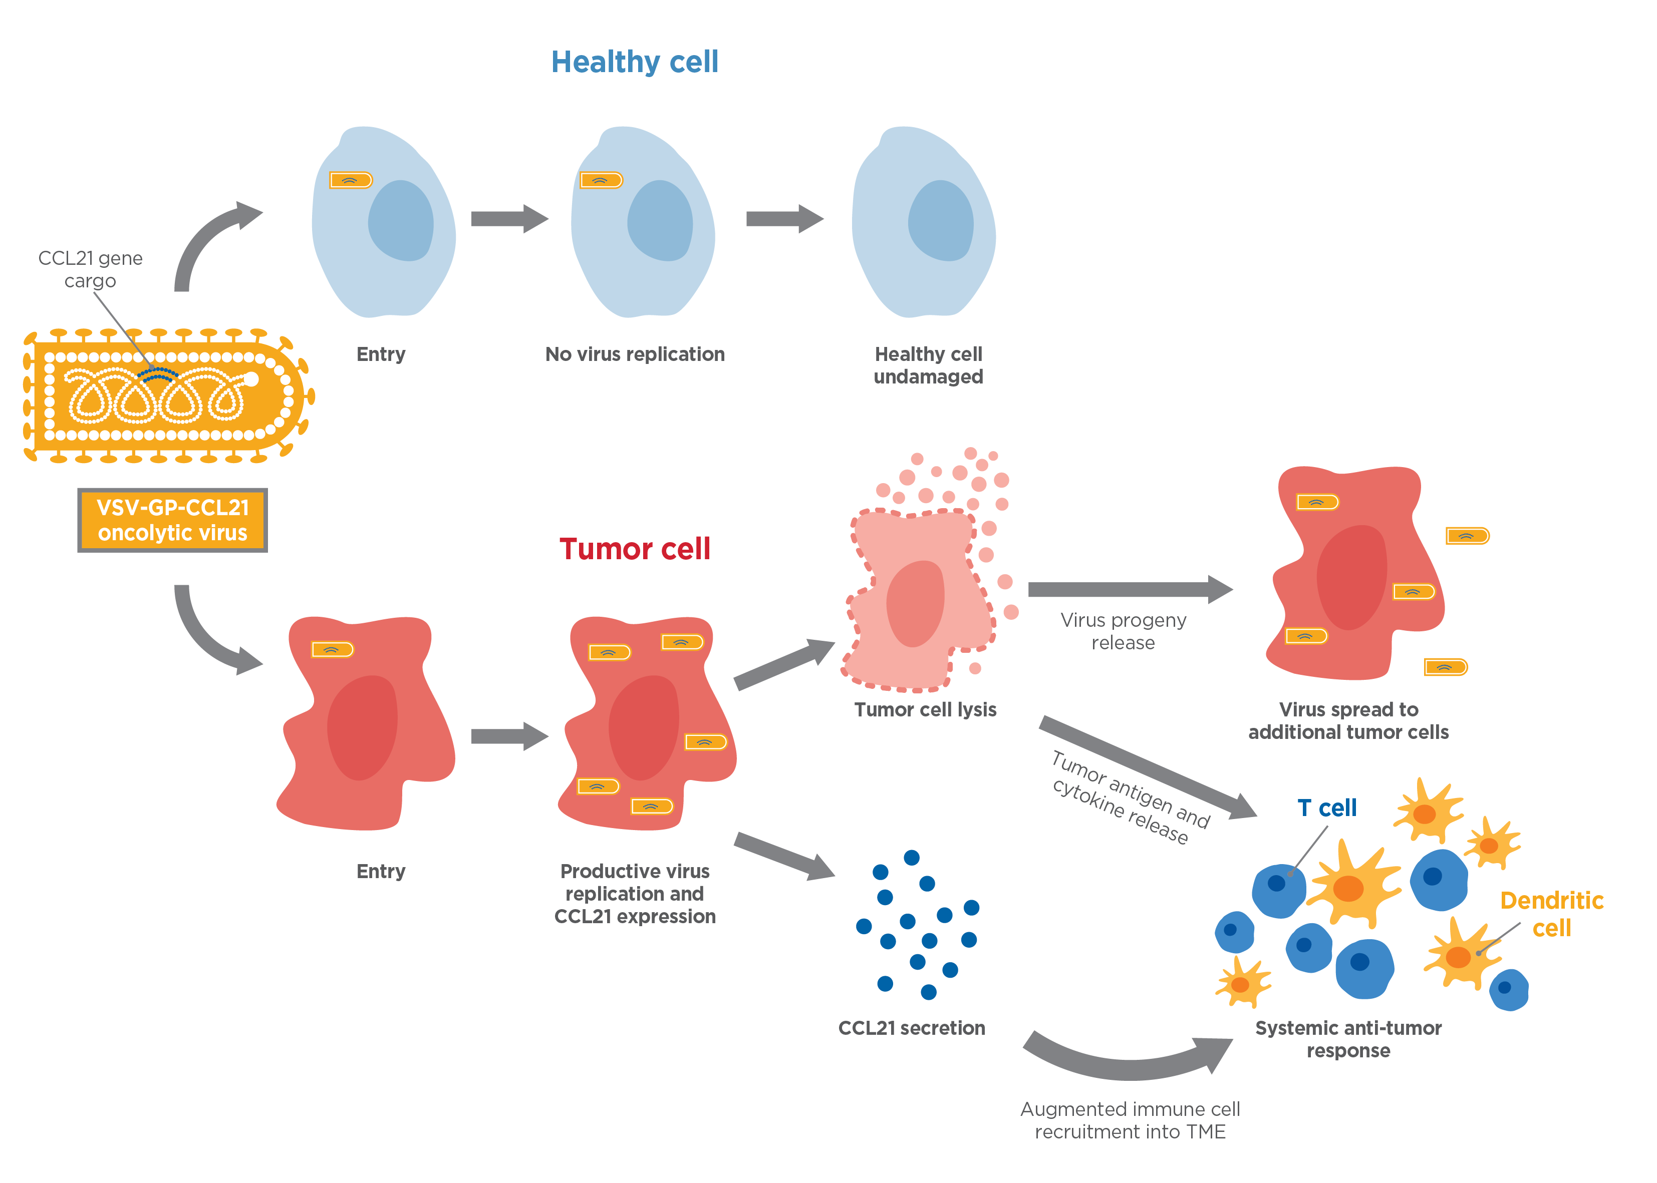
Novel therapeutic platforms: VSV-GP
VSV-GP is a first-in-class approach which exhibits promising characteristics for a next-generation oncolytic virus therapy in the clinic¹
Highly specific killing of tumor cells is enabled by the defective innate immunity of cancer cells¹
Activity has been observed preclinically in a broad spectrum of solid cancer cell types (colon, lung, prostate, brain, ovarian and melanoma)¹
The virus is non-mutagenic and does not integrate into the host genome²
The viral platform can be armed with additional therapeutic genes²
The engineered glycoprotein of VSV-GP allows for repeated systemic administration² and confers a favorable safety profile without significant neurotoxicity¹
Gene cargo
Entry
Non-productive viral replication
Healthy cell protected
VSV-GP-gene cargo
oncolytic virus
Tumor cell killing
Virus spread to additional tumor cells
Entry
Productive virus replication and expression of gene cargo protein
Secretion of gene cargo product
Systemic anti-tumor immune response
TME, tumor microenvironment; VSV-GP, vesicular stomatitis virus glycoprotein.
1. Muik A, et al. Cancer Res 2014;74(13):3567–78; 2. Tober R, et al. J Virol 2014;88(9):4897–907.

Slide 25
Summary

Slide 26
Summary
Oncolytic viruses represent a potential novel class of immunologic treatment for solid tumors, designed to kill cancer cells while sparing healthy cells¹
They act through multiple mechanisms, both locally within the tumor and with the potential to induce systemic immunity against the tumor²
Oncolytic viruses may be combined with currently available and developmental therapies (e.g. anticancer vaccines), with possible additive or synergistic effects^{3–9}
Various virus platforms employ different viruses and genetic modifications that may potentially target specific tumor types, deliver therapeutic payloads, protect the virus from the immune response and enhance tumor killing activity^{1,5,10,11}
The numerous virus platforms in development are testament to the growing interest in this new therapeutic option^{12–16}
1. Fountzilas C, et al. Oncotarget 2017;8(60):102617–39; 2. Kaufmann HL, et al. Nat Rev Drug Discov 2015;14(9):642–62; 3. Lawler SE, et al. JAMA Oncol 2017;3(6):841–49; 4. Martin NT, Bell JC. Mol Ther 2018;26(6):1414–22; 5. Russell SJ, et al. Nat Biotechnol 2012;30(7):658–70; 6. Tomita Y, et al. Mol Cancer Ther 2019;18(8):1418–29; 7. Hemminki O, et al. J Hematol Oncol 2020;13(1):84; 8. Kon T, et al. TCR 2012;1(1):6–14; 9. Chung S-M, et al. Gene Ther 2002;9(1):75–80; 10. Melzer MK, et al. Biomedicines 2017;5(1):8; 11. Maroun J, et al. Future Virol 2017;12(4):193–213; 12. Geletneky K, et al. Mol Ther 2017;25(12):2620–34; 13. ClinicalTrials.gov. NCT03004183. https://clinicaltrials.gov/ct2/show/NCT03004183 (Accessed: August 2020); 14. ClinicalTrials.gov. NCT01470794. https://clinicaltrials.gov/ct2/show/NCT01470794 (Accessed: August 2020); 15. ClinicalTrials.gov. NCT00235482. https://clinicaltrials.gov/ct2/show/NCT00235482 (Accessed: August 2020); 16. ClinicalTrials.gov. NCT02062827. https://clinicaltrials.gov/ct2/show/NCT02062827 (Accessed: August 2020).

