Slide 1
Molecular testing in NSCLC

Slide 2
Outline
Why do we need molecular testing?
What are the available methods for molecular testing?
  Targeted vs comprehensive testing
  Solid vs liquid biopsy
What are the guidelines for molecular testing?
Special focus: EGFR mutation testing through liquid biopsy in NSCLC
EGFR, epidermal growth factor receptor; NSCLC, non-small cell lung cancer.

Slide 3
Rationale for molecular testing in NSCLC
Molecular testing is central to selection of effective therapeutic options in NSCLC¹
Targeted therapies have significantly improved outcomes for patients with NSCLC:^{2,3}
  Meta-analysis of trials of EGFR TKIs compared with chemotherapy in patients with NSCLC reports significantly longer PFS with EGFR TKI treatment: HR (95% CI) 0.266 (0.20, 0.35) (p<0.0001)²
PFS results from Phase III RCTs of first-line EGFR TKI treatment vs chemotherapy for EGFR-mutated NSCLC⁴
Trial | N (EGFR TKI / chemotherapy) | Median PFS (months) | p value
North-East Japan Study Group^{5,6} | 114/114 | 10.8 vs 5.4 | <0.001
WJTOG3405⁷ | 86/86 | 9.2 vs 6.3 | <0.0001
OPTIMAL^{8,9} | 82/72 | 13.1 vs 4.6 | <0.0001
EURTAC¹⁰ | 86/87 | 9.7 vs 5.2 | <0.0001
LUX-Lung 3¹¹ | 230/115 | 11.1 vs 6.9 | 0.001
LUX-Lung 6¹² | 242/122 | 11 vs 5.6 | <0.0001
CI, confidence interval; EGFR, epidermal growth factor receptor; HR, hazard ratio; NSCLC, non-small cell lung cancer; PFS, progression-free survival; RCT, randomised controlled trial;
TKI, tyrosine kinase inhibitor.
1. Savas P, et al. J Thorac Dis 2013;5(Suppl 5):S579–S592; 2. Normando SR, et al. Anticancer Drugs 2015;26(9):995–1003; 3. Greenhalgh J, et al. Cochrane Database Syst Rev 2016;(5):CD010383; 4. Sculier JP, et al. Eur Respir Rev 2015;24:23–9; 5. Maemondo M, et al. N Engl J Med 2010;362:2380–8; 6. Inoue A, et al. Ann Oncol 2013;24(1):54–9; 7. Mitsudomi T, et al. Lancet Oncol 2010;11(2):121–8; 8. Zhou C, et al. Lancet Oncol 2011;12(8):735–42; 9. Zhou C, et al. Ann Oncol 2015;26(9):1877–83; 10. Rosell R, et al. Lancet Oncol 2012;13(3):239–46; 11. Sequist LV, et al. J Clin Oncol 2013;31(27):3327–34; 12. Wu WL, et al. Lancet Oncol. 2014;15(2):213–22.

Slide 4
Molecular targets in NSCLC
Molecular testing for targetable oncogenic alterations has become standard practice in NSCLC¹
Several molecular drivers for oncogene addiction have been identified as therapeutic targets and predictive biomarkers (they are generally mutually exclusive):¹
Biomarker | Alteration of Interest | Approximate frequency in NSCLC | ESMO NSCLC targeted therapy recommendations¹*
Oncogenic driver
EGFR | Exon 19 deletion; L858R point mutation in exon 21 L861Q point mutation in exon 21; G719X in exon 18; other rarer activating mutations | 15% in Western populations² 35–50% in Asian populations² | EGFR TKIs
 | T790M mutation in exon 20 | 60% following progression on EGFR TKI² | 3rd generation TKIs
ALK | ALK rearrangement | 3–7%² | ALK inhibitors
ROS1 | ROS1 rearrangement | 1–2%² | ALK/MET inhibitor
BRAF | V600E mutation | 1–3%² | BRAF/MEK inhibitors
HER2 | p.A775 G776insYVMA in exon 20 | 1–2% in adenocarcinomas³ | Insufficient data available to support the targeting of HER2 dysregulation
 | Gene amplification | 1–2% in adenocarcinomas³
MET | Splice site mutations around or in exon 14 | 3–4% in adenocarcinomas³ | MET-directed TKIs undergoing development
 | Gene amplification | 2–4% in adenocarcinomas³
Protein
PD-L1 | High protein expression | 30% of advanced stage NSCLC have high PD-L1 expression (tumour proportion score of >50%)² | Anti-PD-1 / anti-PD-L1 ICIs
*Not all drugs within the stated class are necessarily approved for use; summary of product characteristics should be consulted regarding drug-specific approvals and indications.
ALK, anaplastic lymphoma kinase; EGFR, epidermal growth factor receptor; ESMO, European Society for Medical Oncology;HER2, human epidermal growth factor receptor 2; ICI, immune checkpoint inhibitor; NSCLC, non-small cell lung cancer; ROS1, c-ros oncogene 1; TKI, tyrosine kinase inhibitor; PD-1, programmed death-1; PD-L1, programmed death-ligand 1.
1. Planchard D, et al. Ann Oncol 2018;29(Suppl. 4):iv192–iv237 [Published online 3 October 2018; updated 26 January 2019]; 2. Ahmadzada T, et al. J Clin Med 2018;7:E153;
3. Shim HS, et al. J Pathol Transl Med 2017;51:242–54

Slide 5
Outline
Why do we need molecular testing?
What are the available methods for molecular testing?
  Targeted vs comprehensive testing
  Solid vs liquid biopsy
What are the guidelines for molecular testing?
Special focus: EGFR mutation testing through liquid biopsy in NSCLC
EGFR, epidermal growth factor receptor; NSCLC, non-small cell lung cancer.

Slide 6
Molecular testing methods
There is a range of molecular testing methods available, each with respective advantages and disadvantages:
Approach | Method | Examples |  | Abnormalities detected in NSCLC | Turnaround* | Advantages | Disadvantages
Molecular pathology | Immunohistochemistry^{1–4} |  | PD-L1, ALK, ROS1 | 2−3 days | Can detect alterations in protein expression and localisation, point mutation Rapid diagnosis, sensitive, specific | Heterogeneity of staining (approximately 30% of positive slides) Need sufficient tumour tissue Sampling variation may affect results (such as in PD-L1 testing)
 | FISH^{2,3,5} |  | ALK, ROS1, RET | 2−3 days | Can detect gene rearrangement, chromosomal inversion or translocation, fusions with variant partners Easily applicable to FFPE samples | Unable to detect point mutations, insertions/deletions
Sequencing | Sanger sequencing, Pyrosequencing^{1,4,6} |  | All genomic abnormalities | 1−3 days | Relatively rapid, easy to use May be used to discover novel mutations | Often slower, less sensitive and more labour-intensive than allele-specific testing methods Lower throughput, not practical for wide or deep coverage
 | Allele-specific testing^{4,7,8} | ARMS | Previously identified mutations in EGFR, BRAF, MET, etc. | 1–3 days | High sensitivity and specificity Rapid, easy to use | Can only detect prespecified mutations
 |  | ddPCR
 |  | BEAMing
 | NGS^{1,4,6} | Targeted NGS | All genomic abnormalities, tumour mutation burden | ≥1 week | Can detect multiple targets and alteration types simultaneously Ideal method to discover novel mutations | Expensive, takes time Lower sensitivity (may be improved by increased depth) Need for extensive expertise and infrastructure High call error
 |  | Whole-exome sequencing
 |  | Whole-genome sequencing
*May vary based on factors, such as complexity of assay, platform used and test centre.
ALK, anaplastic lymphoma kinase; ARMS, Amplification Refractory Mutation System; BEAM, beads, emulsion, amplification, magnetics; ddPCR, droplet digital polymerase chain reaction; EGFR, epidermal growth factor receptor; FFPE, formalin-fixed, paraffin-embedded; FISH, fluorescence in situ hybridisation; NGS, next-generation sequencing; NSCLC, non-small cell lung cancer; PD-L1, programmed death-ligand 1; RET, rearranged during transfection; ROS1, c-ros oncogene 1.

Slide 7
Testing can be targeted or more comprehensive
Most targeted¹
Most comprehensive¹
Single-target testing
(e.g. IHC, FISH,
allele specific)
Multiplex testing
(sequencing, multiplex PCR, etc.)
Targeted-exome
NGS
Whole-exome NGS
Whole-genome NGS
Strengths of targeted testing:
Strengths of comprehensive testing:
Availability of standardised
testing platforms¹
Provides valuable data on:
  Increased sensitivity²
  Resistance mechanisms⁶
versus
comprehensive
testing
  Reduced turnaround time²
  Tumour evolution^{6,7}
  Reduced cost³
  Novel molecular targets^{3,7}
  Reduced quantity of tumour material required^{4,5}
  Potential biomarkers for existing therapies
  (e.g. tumour mutation burden)⁶
FISH, fluorescence in situ hybridisation; IHC, immunohistochemistry; NGS, next-generation sequencing; PCR, polymerase chain reaction.

Slide 8
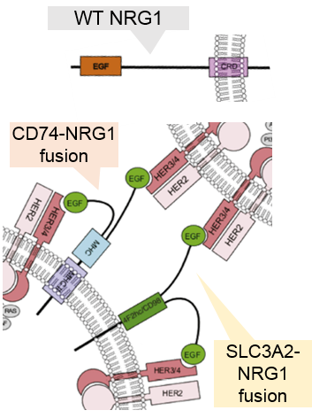
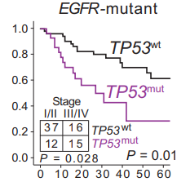
Comprehensive testing: advantages
Comprehensive testing methods (e.g. whole-genome and -exome NGS) may provide important research information on novel molecular targets and biomarkers:
Novel targets
Less common, but targetable, oncogenic
drivers associated with NSCLC¹⁻³
Biomarkers
Coexisting alterations that may influence
outcomes of EGFR mutation+ patients^{4,5}
NRG1 fusion proteins
that activate oncogenic HER2/HER3 and
PI3K-AKT signaling
are found in 0.3% of
NSCLC cases^{1,2}
NRG1 fusions are also considered to be a potential mechanism of resistance
to ALK inhibitors³
Alterations in TP53
were found in >50%
of EGFR mutation+ NSCLC, and more frequently detected in patients with progression on second-line therapy⁴
TP53 mutations have been associated with inferior survival
in EGFR mutation+ patients⁵
Probability of survival
Months
Figure adapted from Gay ND, et al. 2017.²
ALK, anaplastic lymphoma kinase; CRD, cysteine-rich domain; EGFR, epidermal growth factor receptor; HER, human epidermal growth factor receptor; MHC, major histocompatibility complex; mut, mutated;
NGS, next-generation sequencing; NRG1, neuregulin 1; NSCLC, non-small cell lung cancer; PI3K, phosphoinositide 3-kinase; SLC3A2, Solute Carrier Family 3 Member 2; TP53, tumour protein 53; WT/wt, wild type.
1. Liu SV, et al. J Clin Oncol 2018;36(15_suppl):12084–12084; 2. Gay ND, et al. J Thorac Oncol 2017;12(8):e107–e110; 3. McCoach CE, et al. Clin Cancer Res. 2018;24(14):3334–47; 4. Blakely CM, et al. Nat Genet. 2017;49(12):1693–704; 5. CLCGP, NGM. Sci Transl Med 2013;5(209):209ra153.

Slide 9
Molecular test sample considerations
Type of specimen
Tumour tissue fixation²
Tumour cell content
Prefixation time should be minimised:
  Biochemical alterations begin to
  occur within 10 minutes
  <6 hours: FISH and IHC analysis adversely affected
  >48 hours: DNA quality deteriorates, resulting in weaker FISH signals
Formalin fixation is recommended for biopsy specimens; alcohol fixation generates superior nucleic acid yield, but may alter the nucleus’ morphologic details
Frozen specimens provide high-quality nucleic acids and proteins, and are optimal for molecular analysis, but do not preserve morphologic details well
Mutation testing requires approximately 100–400 tumour cells; more sensitive methods are utilised for lower tumour
cell yields.² Test-specific tumour cell requirements:
FISH: 50–100 assessable tumour cells¹
Sanger sequencing: ≥40–50% tumour cell content of the sample^{1,2}
Comprehensive genomic analysis: >60% tumour cellularity and <20% necrosis²
PCR-based methods: 1% mutant DNA content¹
PCR-based vs hybrid capture-based NGS: ≥5–10 ng of total DNA (~1,000 cells) vs 100–200 ng of RNA/DNA³
Histologic and cytologic samples are both acceptable^{1,2}
  Detection rates of EGFR mutations (for example) are comparable for cytology and tissue samples
Molecular testing can be carried out using genetic material from tumour tissue or ctDNA, but negative ctDNA results require verification by tissue biopsy¹
ctDNA, circulating tumour DNA; DNA, deoxyribonucleic acid; EGFR, epidermal growth factor receptor; FISH, fluorescence in situ hybridisation; IHC, immunohistochemistry; NGS, next-generation sequencing;
PCR, polymerase chain reaction; RNA, ribonucleic acid.

Slide 10
Conclusions: targeted vs comprehensive testing
Targeted molecular testing (including targeted NGS) may be more appropriate for routine clinical use than comprehensive testing, as it: ^{1,2}
  Offers faster turnaround time
  Offers higher sensitivity
  Is lower cost
Whole-exome NGS may be considered when sufficient samples and resources are available; it can provide valuable data that may be missed by targeted molecular testing^{3–5}
Whole-exome sequencing may play a more central role in routine clinical use in the near future as a result of rapidly evolving technologies
NGS, next-generation sequencing.
1. Sholl L. Transl Lung Cancer Res 2017;6(5):560–9; 2. Garinet S, et al. J Clin Medi 2018;7(6):144; 3. Chung MJ, et al. J Mol Genet Med 2017;11:262 ; 4. Dubbink HJ, et al. Mol Oncol 2014;8(4):830–9; 5. Coco S, et al. Curr Drug Targets 2015;16(1):47–59

Slide 11
Outline
Why do we need molecular testing?
What are the available methods for molecular testing?
  Targeted vs comprehensive testing
  Solid vs liquid biopsy
What are the guidelines for molecular testing?
Special focus: EGFR mutation testing through liquid biopsy in NSCLC
EGFR, epidermal growth factor receptor; NSCLC, non-small cell lung cancer.

Slide 12
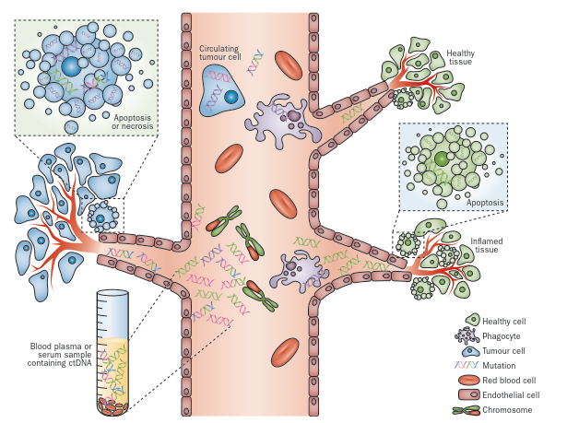


Molecular testing using solid vs liquid biopsy
Molecular tests can use genetic material from tumour tissue (solid biopsy) or from ctDNA (liquid biopsy)^{1,2}
Solid biopsy
Liquid biopsy
Blood plasma or serum sample
Surgically removed tumour tissue
Other samples (urine, CSF, pleural effusion)

Slide 13

Liquid biopsy complements solid biopsy
Liquid biopsy offers an efficient and non-invasive assessment method for screening and follow-up^{1–3}
Circulating biomarkers have the potential to monitor minimal residual disease, forecast early progression
and document subclonal evolution through therapy and acquired drug resistance⁴
Owing to the potential for false-negative results with liquid biopsy, solid biopsy is strongly recommended to confirm negative results³
Liquid biopsy: strengths
Simple, fast and cost-effective^{1,2}
  Minimally invasive assessment/monitoring:^{1,2}
    Especially of inaccessible tumours
    Ideal for longitudinal surveillance
  Captures tumour heterogeneity and molecular drivers of metastases^{1,2}
  Can provide prognostic information^{1,5}
Liquid biopsy: limitations
Typically have reduced sensitivity vs solid biopsies⁶
Validation studies report ~30% of patients have
no alterations in ctDNA*^{7,8}
Risk of false negatives when ctDNA levels are low
in early disease or when the tumour is responding
to therapy^{6,9}
No direct correlation with histology or cellular phenotype⁶
*Other factors that may affect concordance between solid- and liquid-based biopsy samples: tumour type, heterogeneity, time between tumour and blood sampling, and whether the variant is clonal or subclonal.⁶
ctDNA, circulating tumour deoxyribonucleic acid.

Slide 14
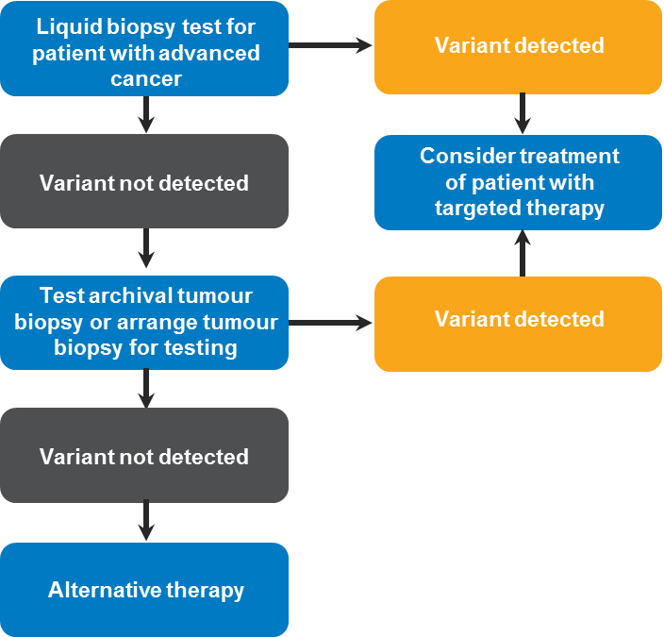
Why do we still need solid biopsies?
Liquid biopsies (using ctDNA) can be less sensitive than solid (tumour tissue) biopsies:¹
  ctDNA levels are low in the early stage of primary cancer or when the tumour is responding to therapy, possibly leading to false-negative results^{1,2}
  Validation studies report no alterations in ctDNA
  in approximately 30% of patients*^{3,4}
Information on histology (e.g. small-cell transformation) can be gathered only via solid biopsies¹
Liquid biopsies, therefore, represent a complementary approach to tissue-based testing:
  Solid biopsy is strongly recommended for diagnosis;
  liquid biopsy can be beneficial for follow-up screening⁵
  Negative results with liquid biopsy should always be confirmed with solid biopsy¹
Reflex tumour biopsy testing in patients with negative liquid biopsy results¹
*Other factors that may affect concordance between solid- and liquid-based biopsy samples: tumour type, heterogeneity, time between tumour and blood sampling, and whether the variant is clonal or subclonal.¹
Figure adapted from Mercker JD, et al. 2018.¹
ctDNA, circulating tumour deoxyribonucleic acid
1. Merker JD, et al. J Clin Oncol. 2018;36(16):1631–41; 2. Bettegowda C, et al. Sci Transl Med 2014;6(224):224ra24; 3. Clark TA, et al. J Mol Diagn 2018;20(5):686–702; 4. Odegaard JI, et al. Clin Cancer Res 2018;24(15):3539–49; 5. Planchard D, et al. Ann Oncol 2018;29(Suppl. 4):iv192–iv237

Slide 15
The future of liquid biopsies
In the future, liquid biopsies using ctDNA may become the new diagnostic standard:
  Therascreen® EGFR RGQ PCR kit (Qiagen) was approved as a companion diagnostic for the detection of EGFR del19 and L858R in the European Union in 2015¹
  The FDA approved the cobas® EGFR Mutation Test v2 (Roche) in 2016, making it the first liquid biopsy NGS panel to achieve regulatory approval*^{2,3}
Emerging technologies may improve the sensitivity and specificity of liquid biopsies:²
  The FDA has granted Breakthrough Device designation to Foundation Medicine’s expanded FoundationACT assay, a 70-gene panel, NGS-based in vitro diagnostic device*^{2,4}
Alternative sources of ctDNA may enter routine clinical practice:⁵
  Using 60 evaluable NSCLC tumour tissue specimens as the reference standard, the sensitivity
  of EGFR mutation detection in urine was 72% for T790M, 75% for L858R and 67% for exon
  19 deletions
*Not approved in the EU.
ctDNA, circulating tumour deoxyribonucleic acid; EGFR, epidermal growth factor receptor; FDA, US Food and Drug Administration; NGS, next-generation sequencing; NSCLC, non-small cell lung cancer.
1. Ou SI, et al. Am Soc Clin Oncol Educ Book 2018;38:978–97; 2. Neumann MHD, et al. Comput Struct Biotechnol J 2018;16:190–5; 3. US Food and Drug Administration. FDA News release: FDA approves first blood test to detect gene mutation associated with non-small cell lung cancer. www.fda.gov/newsevents/newsroom/pressannouncements/ucm504488.htm (Accessed: July 2019); 4. Foundation Medicine. Press Release: Foundation Medicine’s New Liquid Biopsy Assay Granted Breakthrough Device Designation by U.S. Food and Drug Administration. http://investors.foundationmedicine.com/news-releases/news-release-details/foundation-medicines-new-liquid-biopsy-assay-granted (Accessed: July 2019); 5. Reckamp KL, et al. J Thorac Oncol. 2016;11(10):1690–700.

Slide 16


Combining molecular testing methods
Hypothesised approach to combining molecular testing methods within clinical practice in order
to improve understanding of the impact of intra-tumour heterogeneity on disease progression and clinical outcome¹
X
Treatment
Surgical resection of primary tumour ± lymph nodes
Diagnosis
Metastatic disease
Clinical pathway
Minimally invasive methods
CTCs
ctDNA
Histology – tumour subtyping
IHC – expression of key proteins
FISH – chromosomal instability
FACS – DNA ploidy analysis
Molecular pathology
Clinical pathway
Whole-exome sequencing
Single nucleotide variants, indels, CNVs
Phylogenetic tree construction
Intratumour heterogeneity outcome
Analysis of multi-region primary and metastatic samples

Slide 17
Outline
Why do we need molecular testing?
What are the available methods for molecular testing?
  Targeted vs comprehensive testing
  Solid vs liquid biopsy
What are the guidelines for molecular testing?
Special focus: EGFR mutation testing through liquid biopsy in NSCLC
EGFR, epidermal growth factor receptor; NSCLC, non-small cell lung cancer.

Slide 18
ESMO advanced NSCLC molecular testing guidelines: overview (2019)
ESMO supports molecular testing for oncogenic drivers in all patients with advanced, possible, probable or definite adenocarcinoma:¹
Biomarker | Summary ESMO recommendation¹ |  |  | LoE, GoR
Oncogenic driver
EGFR mutation status | Histology | Advanced non-squamous NSCLC | Testing should be systematically carried out | I, A
 |  | SqCC of the lung | Not recommended except in unusual cases, e.g. never-/former light smokers or long-time ex-smokers | IV, A
 | Testing coverage |  | Should have adequate coverage of mutations in exons 18–21, including those associated with resistance to some therapies [III, B]. Minimally, the most common activating mutations (exon 19 deletion, exon 21 L858R point mutation) should be determined [I, A] | ─
T790M | T790M testing on disease relapse is mandatory |  |  | I, A
ALK translocation | Histology | Advanced non-squamous NSCLC | Testing should be systematically carried out | I, A
 |  | SqCC of the lung | Not recommended except in unusual cases, e.g. never-/former light smokers or long-time ex-smokers | IV, A
 | Methodology |  | Detection by FISH remains a standard, but IHC with high-performance ALK antibodies and validated assays may be used for screening [III, A], and have recently been accepted as an equivalent alternative to FISH for ALK testing | ─
ROS1 rearrangement | Advanced NSCLC |  | Testing should be systematically carried out | III, A
 | Methodology |  | Detection of the ROS1 translocation by FISH remains a standard; IHC may be used as a screening approach | IV, A
BRAF mutation | Advanced NSCLC: BRAF V600 mutation status should be systematically carried out |  |  | II, A
Protein
PD-L1 expression | Testing should be systematically determined in advanced NSCLC |  |  | I, A
ALK, anaplastic lymphoma kinase; EGFR, epidermal growth factor receptor; ESMO, European Society for Medical Oncology; FISH, fluorescence in situ hybridisation; GoR, grade of recommendation;
IHC, immunohistochemistry; LoE, level of evidence; NSCLC, non-small cell lung cancer; PD-L1, programmed death-ligand 1; ROS1, c-ros oncogene 1; SqCC, Squamous cell carcinoma
1. Planchard D, et al. Ann Oncol 2018;29(Suppl. 4):iv192–iv237.

Slide 19
ESMO advanced NSCLC molecular testing guidelines:
at-a-glance summary
EGFR mutation status should be systematically analysed in advanced NSCLC^{1,2} | Testing for ALK rearrangement should be systematically carried out in advanced NSCLC^{1,2}
Test methodology should have adequate coverage for mutations in exons 18–21 When resources/materials are limited, the most common activating mutations* should be determined Molecular EGFR testing is not recommended in patients with a confident diagnosis of SqCC of the lung, except in never- / former light smokers (<15 pack-years) | Detection of the ALK translocation by FISH remains the standard PCR or RT-PCR may also be used IHC with high-performance ALK antibodies may be considered for screening
Multiplex platforms for molecular testing are preferable^{1,2}
In patients with EGFR-sensitising mutations or ALK translocations, a rebiopsy at the time of progression is encouraged²
*Exon 19 deletion and the exon 21 L858R point mutation, including exon 20 T790M.
ALK, anaplastic lymphoma kinase; EGFR, epidermal growth factor receptor; ESMO, European Society for Medical Oncology; FISH, fluorescence in situ hybridisation; IHC, immunohistochemistry;
NSCLC, non-small cell lung cancer; PCR, polymerase chain reaction; SqCC, squamous cell carcinoma; RT-PCR, reverse transcription polymerase chain reaction.
1. Planchard D, et al. Ann Oncol 2018;29(Suppl. 4):iv192–iv237; 2. Novello S, et al. Ann Oncol 2016;27(Suppl. 5):v1–v27.

Slide 20
NCCN NSCLC molecular testing guidelines
The NCCN recommends that (minimally) EGFR mutations, BRAF mutations, ALK rearrangements, ROS1 rearrangements and PD-L1 expression levels should be tested in patients with metastatic non-squamous NSCLC:¹
Biomarker | Summary NCCN recommendation¹ |  |  | Category
Oncogenic driver
EGFR mutation status | Histology | Non-squamous NSCLC | Testing is recommended | I
 |  | NSCLC, not otherwise specified | Testing is recommended | I
ALK rearrangement | Histology | Non-squamous NSCLC | Testing is recommended | I
 |  | NSCLC, not otherwise specified | Testing is recommended | I
ROS1 rearrangement | Histology | Non-squamous NSCLC | Testing is recommended | 2A
 |  | NSCLC, not otherwise specified | Testing is recommended | 2A
BRAF mutations | Histology | Non-squamous NSCLC | Testing is recommended | 2A
 |  | NSCLC, not otherwise specified | Testing is recommended | 2A
 |  | Squamous NSCLC | Testing can be considered | 2A
Protein
PD-L1 expression | IHC testing for PD-L1 expression is recommended in patients with metastatic NSCLC, ideally before first-line treatment |  |  | 1
ALK, anaplastic lymphoma kinase; EGFR, epidermal growth factor receptor; IHC, immunohistochemistry; NCCN, National Comprehensive Cancer Network; NSCLC, non-small cell lung cancer;
PD-L1, programmed death-ligand 1; ROS1, c-ros oncogene 1.

Slide 21
CAP/IASLC/AMP molecular testing guidelines 2018¹
Molecular testing guidance for the selection of lung cancer patients for TKI treatment:
EGFR/ALK
Universal testing for mutations in EGFR exons 18–21 and using FISH for ALK rearrangements in advanced lung adenocarcinoma is recommended:
Cell blocks or cytologic preparations may be used for molecular testing; assays must be able to detect molecular alterations in specimens with >20% cancer cells
New genes
ROS1 testing must be performed on all lung adenocarcinoma patients:
ROS1 IHC may be used as a screening test; however, positive results should be conﬁrmed by a molecular or cytogenetic method
BRAF,* RET, HER2, MET and KRAS molecular testing are currently not indicated as a routine stand-alone assay outside the context of a clinical trial
Methods
IHC is an equivalent alternative to FISH for ALK testing
Multiplexed genetic sequencing panels are preferred over multiple single-gene tests
Cell-free
plasma DNA
When tissue is limited or insufﬁcient for molecular testing, a cell-free plasma DNA assay may be used to identify EGFR mutations:
Cell-free plasma DNA methods may be used to identify EGFR T790M mutations in patients with progression or secondary clinical resistance to EGFR TKIs; testing of the tumour sample is recommended if the result is negative
*ASCO expert panel recommends BRAF testing on all patients with advanced lung adenocarcinoma, irrespective of clinical characteristics.²
ALK, anaplastic lymphoma kinase; AMP, Association for Molecular Pathology; CAP, College of American Pathologists; DNA DNA, deoxyribonucleic acid; EGFR, epidermal growth factor receptor; FISH, fluorescence in situ hybridisation; HER2, human epidermal growth factor receptor 2; IASLC, International Association for the Study of Lung Cancer; IHC, immunohistochemistry; KRAS, Kirsten rat sarcoma viral oncogene homologue; RET, rearranged during transfection; ROS1, c-ros oncogene 1; TKI, tyrosine kinase inhibitor.

Slide 22
Outline
Why do we need molecular testing?
What are the available methods for molecular testing?
  Targeted vs comprehensive testing
  Solid vs liquid biopsy
What are the guidelines for molecular testing?
Special focus: EGFR mutation testing through liquid biopsy in NSCLC
EGFR, epidermal growth factor receptor; NSCLC, non-small cell lung cancer.

Slide 23
EGFR mutation testing via liquid biopsy^{1–8}
Liquid biopsy-based molecular testing methods have been extensively studied for EGFR mutation testing in NSCLC resulting in a number of experimental
and commercial platforms
The sensitivity and specificity of
the available assays depend on the:
  Study
  Platform
  Manufacturer
  Target
  Specific mutation
Method | N | Mutation | Sensitivity | Specificity
ARMS: ADx¹ | 86 | EGFR, NS | 67.5% | 100%
ARMS: Qiagen² | 652 | Exon 19 del, L858R, T790M | 65.7% | 99.8%
ARMS: Roche³ | 238 | EGFR, overall | 75% | 96%
 |  | Exon 19 del | 82.5% | 98.3%
 |  | L858R | 62.2% | 99%
 |  | G719x | 50% | 100%
 |  | L861Q | 100% | 100%
ddPCR⁴ | 115 | Exon 19 del | 86% | 100%
 |  | L858R | 69% | 100%
 |  | T790M | 77% | 63%
Super ARMS⁵ | 109 | Exon 19 del, L858R, G719X, exon 20 ins, T790M | 82% | 100%
BEAM⁶ | 216 | Exon 19 del | 82.3% | 97.5%
 |  | L858R | 86.3% | 96.5%
 |  | T790M | 70.3% | 69.0%
NGS: deep⁷ | 288 | Exon 19 del | 51% | 98%
 |  | L858R | 52% | 94%
NGS: ultra deep⁸ | 69 | Exon 19 del, L858R, T790M | 74% | 100%
ARMS, amplification refractory mutation system; BEAM, beads, emulsion, amplification, magnetics; ddPCR; droplet digital polymerase chain reaction; EGFR, epidermal growth factor receptor; NGS, next-generation sequencing NS, not specified; NSCLC, non-small cell lung cancer.
1. Liu X, et al. J Clin Pathol 2013;66:1065–9; 2. Douillard JY, et al. Br J Cancer 2014;110(1):55–62; 3. Mok T, et al. Clin Cancer Res 2015;21(14):3196–203; 4. Sacher AG, et al. JAMA Oncol 2016;2(8):1014–22;
5. Li Y, et al. PLoS One 2017;12(8):e0183331; 6. Oxnard GR, et al. J Clin Oncol 2016;34(28):3375–82; 7. Uchida J, et al. Clin Chem 2015;61(9):1191–6; 8. Marchetti A, et al. J Thorac Oncol 2015;10(10):1437–43.

Slide 24
Detection of ctDNA varies by technique
 | Technique |  | Sensitivity | Optimal application
Therascreen®: T790M detected >7%⁴ | Sanger sequencing¹ |  | >10% | Tumour tissue | ctDNA will be detected in this range
 | Pyrosequencing¹ |  | 10% | Tumour tissue
 | NGS¹ |  | 2% | Tumour tissue
 | Quantitative-PCR¹ |  | 1% | Tumour tissue
 | ARMS¹ |  | 0.1% | Tumour tissue
 | cobas®, Therascreen® (adapted for ctDNA)² |  | 0.1% | ctDNA
 | COLD-PCR³ |  | 0.1% | ctDNA
 | ddPCR¹ |  | 0.01% | ctDNA
Adapted from Diaz JL, et al. J Clin Oncol 2014.¹
ARMS, amplification refractory mutation system; COLD-PCR, co-amplification at lower denaturation temperature polymerase chain reaction; ctDNA, circulating tumour deoxyribonucleic acid;
ddPCR, droplet digital polymerase chain reaction; EGFR, epidermal growth factor receptor; NGS, next-generation sequencing; PCR, digital polymerase chain reaction
1. Diaz JL, A Bardelli. J Clin Oncol 2014;32(6):579–86; 2. Hench IB, et al. Front Med 2018;5:9; 3. Vendrell J, et al. Int J Mol Sci 2017;18(2):264; 4. QIAGEN. therascreen® EGFR RGQ PCR Kit Handbook. 2013. https://www.accessdata.fda.gov/cdrh_docs/pdf12/P120022c.pdf (Accessed: July 2019).

Slide 25
EGFR mutation testing: impact of methodology
The performance of ddPCR and cobas® EGFR Mutation Test v2 (Cobas) for detecting EGFR mutations (T790M, Del19 and L858R) in cell-free plasma DNA was compared in 354 plasma samples from 129 patients with advanced EGFR-mutated lung adenocarcinoma¹
In patients who progressed on EGFR TKI (n=50) treatment, the T790M positive rate was 66% with ddPCR, but only 24% with Cobas¹
Contingency tables comparing results of ddPCR and Cobas for EGFR T790M, exon 19 deletions, and L858R testing in cell-free plasma¹
 | ddPCR | Cobas |  | Total | Concordance/sensitivity/ specificity
 |  | Negative | Positive
T790M | Negative | 283 (79.9%) | 0 (0.0%) | 283 (79.9%) | Concordance rate 86%
 | Positive | 51 (14.4%) | 20 (5.6%) | 71 (20.1%) | Sensitivity 100%
 | Total | 334 (94.4%) | 20 (5.6%) | 354 (100%) | Specificity 85%
Del19 | Negative | 119 (60.7%) | 5 (2.6%) | 124 (63.3%) | Concordance rate 90%
 | Positive | 14 (7.1%) | 58 (29.6%) | 72 (36.7%) | Sensitivity 92%
 | Total | 133 (67.9%) | 63 (32.1%) | 196 (100%) | Specificity 89%
L858R | Negative | 79 (63.7%) | 3 (2.4%) | 82 (66.1%) | Concordance rate 90%
 | Positive | 10 (8.1%) | 32 (25.8%) | 42 (33.9%) | Sensitivity 91%
 | Total | 89 (71.8%) | 35 (28.2%) | 124 (100%) | Specificity 89%
Concordance between ddPCR and Cobas was high, but ddPCR was more sensitive than Cobas.
ddPCR, droplet digital polymerase chain reaction; DNA, deoxyribonucleic acid; EGFR, epidermal growth factor receptor; TKI, tyrosine kinase inhibitor
1. Buder A, et al. Target Oncol 2019;14(2):197–203.

Slide 26
Do we just need a simple yes-or-no answer?
When highly sensitive testing methods are used, appropriate cut-off values should be set in order to:
  Eliminate false-positive results
  Eliminate very low-frequency mutations that would not significantly affect tumour sensitivity
Using highly sensitive methods, de novo baseline (pre-treatment) T790M mutation frequencies range from
35–65%¹
Quantitative, rather than qualitative, evaluation of T790M status improved the specificity of both dPCR- and NGS-based ctDNA testing methods²
T/A ratio:
  Definition: The ratio of the number of T790M alleles to that of activating mutation alleles
  Use: T/A analysis may greatly enhance specificity of dPCR and NGS tests
ctDNA, circulating tumour deoxyribonucleic acid; NGS, next-generation sequencing; dPCR, digital polymerase chain reaction.
1. Attili I, et al. Expert Rev Anticancer Ther 2018;18:1021–30; 2. Iwama E, et al. J Thorac Oncol 2018;13(1):S805.

Slide 27
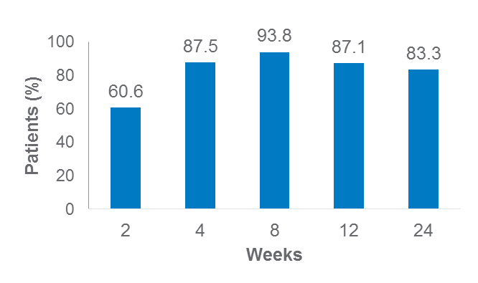
EGFR mutation testing: longitudinal liquid biopsy
Prognostic potential:¹
A Phase II trial of second-generation TKI therapy in EGFR mutation positive patients with NSCLC, evaluated the prognostic value of CMR, defined as EGFR mutation negative status* in plasma)
Of 62.5% of patients (35/56) who were EGFR mutation positive in plasma at baseline, 83.3% had a CMR rate at 24 weeks
Approximately 40% of patients who achieved CMR at any time point maintained CMR at 48 weeks and had durable PFS (>400 days)
Among 14 patients with PD and available plasma samples at the time
of analysis, eight (57.1%) were positive for mutation in plasma
CMR rate during TKI treatment¹
Potential to predict resistance to first/second-generation TKIs:²
A new challenge in the treatment of EGFR-mutated NSCLC patients is to better understand whether:
  Plasmatic progression (T790M-positive in ctDNA, a liquid biopsy) occurs earlier than disease progression according to RECIST
  Treatment decisions based on plasmatic progression could improve outcomes for patients with advanced NSCLC
A multi-centre, Phase II trial is currently investigating the optimum approach to TKI sequencing in patients with advanced NSCLC and common EGFR mutations and evaluating the role of liquid biopsy for the decision-making process: the APPLE trial
*Below the cut-off for the exon 19 deletion or L858R positivity by dPCR.
CMR, complete molecular response; ctDNA, circulating tumour deoxyribonucleic acid; EGFR, epidermal growth factor receptor; NSCLC, non-small cell lung cancer; dPCR, digital polymerase chain reaction; PD, progressive disease; PFS, progression-free survival; RECIST, Response Evaluation Criteria In Solid Tumors; TKI, tyrosine kinase inhibitor.
1. Hayashi et al. J Thorac Oncol. 2017;12:S2144–S2145 ; 2. Remon et al. Clin Lung Cancer. 2017;18:583.

Slide 28
EGFR mutation testing: when, what, how^{1,2}
When | What | How
Diagnosis of stage IV NSCLC | EGFR (exons 18–21) ALK ROS BRAF Also: RET, HER2, MET, KRAS* | Solid biopsy Multiplexed sequencing or allele-specific methods for EGFR, and others FISH/IHC for ALK/ROS
At progression on first/second-generation EGFR TKI | EGFR T790M | Solid or liquid biopsy Multiplexed sequencing or allele-specific methods
At progression on any EGFR TKI | EGFR C797S* Other EGFR TKI resistance mutations (e.g. MET)* | Solid or liquid biopsy Multiplexed sequencing or allele-specific methods
T790M conversion has been reported after treatment with second-generation TKI plus antiangiogenic mAb therapy. Hence, repeated T790M testing might be useful even in previously T790M-negative patients:³
Rebiopsy
(n=5)
T790M+
(n=5)
T790M+
(n=14)
TKI+AA
No rebiopsy
(n=9)
Eligible patients
(n=32)
No rebiopsy
(n=5)
T790M─
(n=18)
TKI+AA
T790M+
(n=8)
Rebiopsy
(n=13)
T790M─
(n=5)
In eight (62%) of 13 T790M-negative patients, T790M status changed from negative to positive after TKI+AA therapy³
1. Lindeman et al. J Mol Diagn. 2018;20:129; 2. Kalemkerian et al. J Clin Oncol. 2018;36:911; 3. Hata et al. Oncotarget. 2018;9:34765-34771.

Slide 29
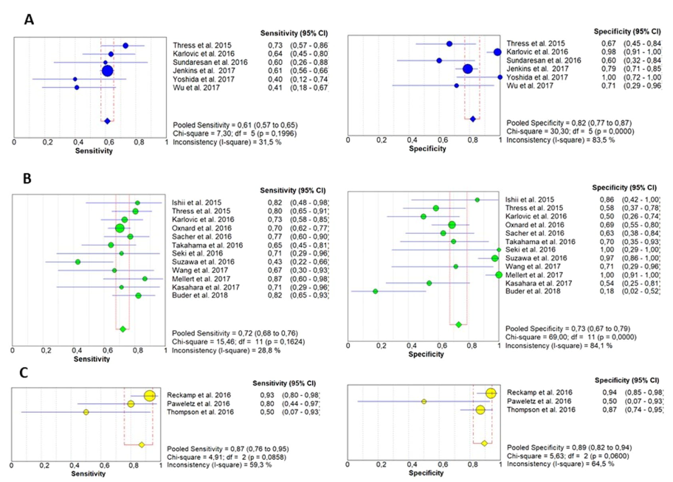
EGFR mutation testing: liquid biopsy
Utility at diagnosis^{1–4}
At progression
Based on a meta-analysis of 21 studies with matched blood and tumour tissue samples from patients with advanced NSCLC who progressed after EGFR TKI therapy:⁵
While negative liquid biopsy results were associated with less-advanced disease characteristics and relatively better prognosis, they did not preclude a benefit with EGFR TKIs^{1–4}
Patients must not be excluded from receiving EGFR TKI therapy based on negative liquid biopsy results
If liquid biopsy will be used at diagnosis for EGFR mutation testing, it must be followed up with solid biopsy in case of
negative results
Use of liquid biopsy is feasible, but negative results must be validated
Overall pooled accuracy of ctDNA analysis: sensitivity = 0.67; specificity = 0.80
No. of studies: 6
Pooled sensitivity:
0.61 (95% CI 0.57–0.65)
Inconsistency: 31.5%
Pooled specificity:
0.82 (95% CI 0.77–0.87)
Inconsistency: 83.5%
RT-PCR
No of studies: 12
Pooled sensitivity:
0.72 (95% CI 0.68–0.76)
Inconsistency: 28.8%
Pooled specificity:
0.73 (95% CI 0.67–0.79)
Inconsistency: 84.1%
dPCR/ddPCR
Higher sensitivity,
lower specificity vs
nondigital PCR
No of studies: 3
Pooled sensitivity:
0.87 (95% CI 0.76–0.95)
Inconsistency: 59.3%
Pooled specificity:
0.89 (95% CI 0.82–0.94)
Inconsistency: 64.5%
NGS
Highest sensitivity
CI, confidence interval; ctDNA, circulating tumour deoxyribonucleic acid; EGFR, epidermal growth factor receptor; dPCR, digital PCR; ddPCR, droplet digital PCR; NGS, next-generation sequencing; NSCLC, non-small cell lung cancer; PCR, polymerase chain reaction; RT-PCR, real-time PCR; TKI, tyrosine kinase inhibitor.
1. Mok T, et al. Clin Cancer Res 2015;21(14):3196–203; 2. Douillard JY, et al. J Thorac Oncol 2014;9(9):1345–53; 3. ClinicalTrials.gov. NCT01203917. https://clinicaltrials.gov/ct2/show/NCT01203917 (Accessed July 2019); 4. Wu YL, et al. Br J Cancer 2017;116(2):175–85; 5. Passiglia F, et al. Sci Rep 2018;8(1):13379.

Slide 30
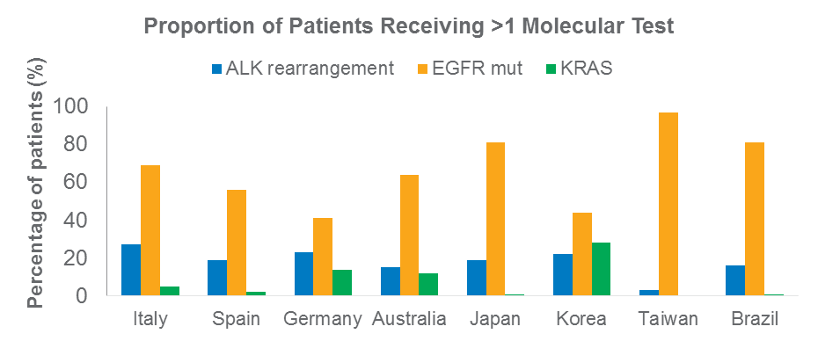
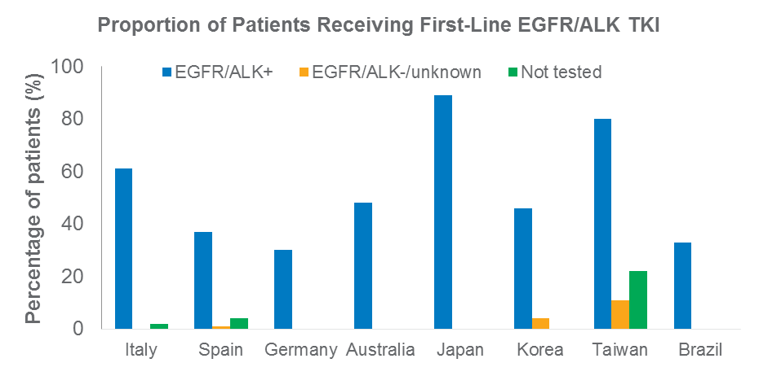
EGFR mutation testing: implementation in practice¹
PIvOTAL observational study:
  Chart review study
  Eight countries: Italy, Spain, Germany, Australia, Japan,
  Korea, Taiwan and Brazil
  1,440 patients with newly-diagnosed advanced
  (stage IIIB/IV) NSCLC
  Initiated systemic therapy from January 2011 through
  June 2013; follow-up until July 2016
Frequency of molecular testing differed across countries;
  EGFR mutation testing was the most commonly conducted test, ranging from 41% (Germany) to 97% (Taiwan)
  EGFR mutation+ tests ranged from 17% (Brazil)
  to 67% (Taiwan)
There was a trend towards increased exposure
to targeted therapies and improved survival in
patients who underwent molecular testing
Testing method and liquid biopsy details were not disclosed

Slide 31
Conclusions: molecular testing in NSCLC
Molecular testing for prognostic and predictive biomarkers has become standard practice in
non-squamous and adenocarcinoma NSCLC, focusing on:^{1,2}
  EGFR mutations, BRAF mutations, ALK rearrangements, ROS1 rearrangements
  PD-L1 expression levels
There is a range of molecular testing methods and sampling preparation approaches; each offers advantages and disadvantages and should be selected according to the specific clinical scenario^{3–8}
  Targeted testing is generally sensitive, fast and economical, and may be preferred in routine care^{9–11}
  More comprehensive approaches (e.g. whole-exome NGS) can provide valuable research data and may become more common in the future as testing technologies evolve^{9,12}
Liquid biopsy represents a less invasive method of testing that holds promise for predictive and prognostic assessment and for the longitudinal evaluation of disease and tumour evolution¹³
  For EGFR mutation testing, some liquid biopsy-based methods can offer specificity and selectivity values of approximately 70% and 95%, respectively^{4,13}
  Solid biopsy-based EGFR mutation testing remains the gold standard at diagnosis,¹ but reliable liquid biopsy could be used for repeat testing upon progression
ALK, anaplastic lymphoma kinase; EGFR, epidermal growth factor receptor; NGS, next-generation signalling; NSCLC, non-small cell lung cancer; PD-L1, programmed death-ligand 1; ROS1, c-ros oncogene 1.

