Slide 1
NSCLC: epidemiology and disease characteristics
NSCLC, non-small cell lung cancer.
Last updated: May 2020

Slide 2
Lung cancer incidence and mortality
The most common cause of cancer death, causing nearly one in five of all cancer deaths worldwide in 2020
One of the most common cancers, with 2.2 million new cases worldwide in 2020
3000
3000
2500
2500
2000
2000
Estimated new cases (thousands)
Estimated deaths (thousands)
1500
1500
1000
1000
500
500
0
0

Slide 3
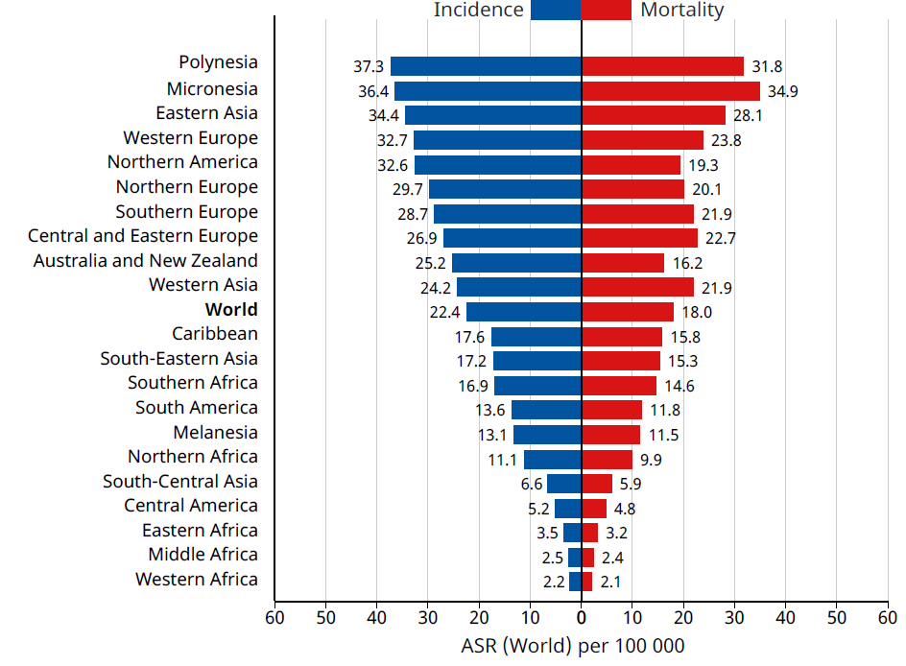
Global distribution of lung cancer
Global incidence and mortality rates¹
In 2020, there were approximately 2,207,000 new cases of lung cancer worldwide²; incidence is estimated to increase by 31% by 2030³
The geographical pattern of lung cancer incidence generally reflects historical patterns in tobacco use⁴
Temporal and geographical patterns of mortality mirror those of incidence owing to lung cancer’s high fatality rate (mortality-to-incidence ratio: 0.87)^{4,5}

Slide 4
Survival rates for lung cancer are generally low
5-year survival trends for various cancers¹
Prostate
Breast
Colorectal
Percentage (%)
High unmet medical need
Lung
Survival rates vary depending on stage at diagnosis. The later the stage of diagnosis, the lower the 5-year survival rate.²
*Data for 2015 are predicted based on the modelled trend..

Slide 5
Stage of diagnosis affects 5-year survival rate
The majority of patients with lung cancer have late-stage disease at diagnosis
The 5-year survival rate is low in patients with late-stage disease

Slide 6
Is there a ‘typical’ lung cancer patient?
Traditionally, the ‘typical’ lung cancer patient was thought to be an older male with a history of smoking. However, recent studies have demonstrated the trend is shifting:
Lung cancer mortality in women, including young women in some countries, has been increasing^{1‒4}
The incidence of lung cancer is now higher in young women (aged 30‒49) than young men in the US⁵
EGFR-mutant tumors are more common in women than men^{6,7}
Tumors that are driven by oncogenic alterations are more common in never-smokers* than smokers^{6,7}
A higher proportion of EGFR-mutant lung cancer occurs in never-smokers than smokers^{6,7}
In patients with adenocarcinoma histology, mutations in EGFR are more prevalent in Asian populations than elsewhere⁸
*Never smokers were defined as those who never smoked or smoked <100 cigarettes in their lifetime.

Slide 7
Tobacco use is the most important risk factor in lung cancer¹
Rates of lung cancer deaths attributable to smoking vary from >80% in the US and France to 61% in Asia and 40% in sub-Saharan Africa¹
Trends in lung cancer mortality rates in a country generally follow trends in smoking prevalence, with lung cancer trends lagging by 20–30 years¹
Over the last few decades lung cancer mortality rates in the EU have been decreasing in men but increasing in women, reflecting a later decline in smoking prevalence among women^{1,2}
Age-standardized EU male and female lung cancer mortality rates²
EU male lung cancer mortality decreased from >50 deaths per 100,000 population in 1990 to 33 deaths per 100,000 population in 2017²*
EU female lung cancer mortality increased from <10 deaths per 100,000 population in 1990 to 15 deaths per 100,000 population in 2017²*
*Mortality rates were estimated for 2017.
EU, European Union.

Slide 8
There are two main types of lung cancer
There are two main types of lung cancer¹
85%
15%
Non-small cell lung cancer
Small cell lung cancer (SCLC)
(NSCLC)
NSCLC usually grows and spreads more slowly than SCLC²

Slide 9
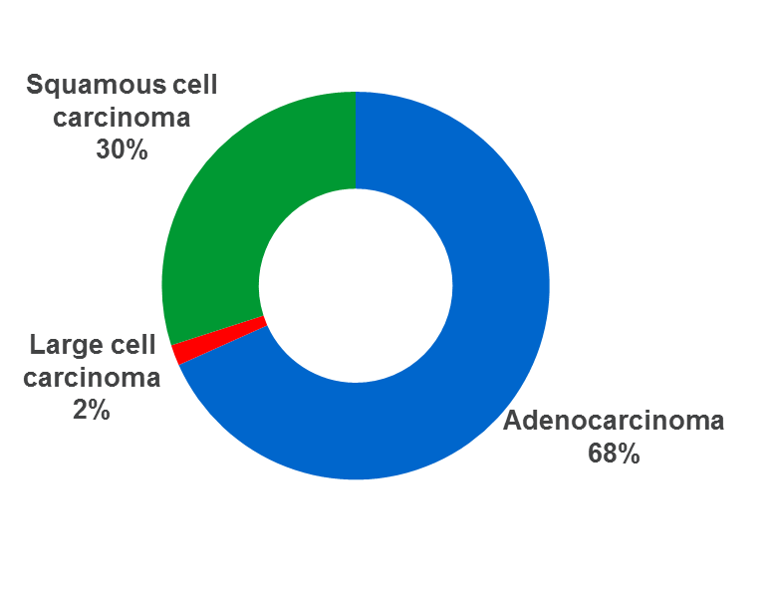
NSCLC is genomically diverse
Histological distribution of NSCLC¹
Driver mutations in adenocarcinoma²
Many of these driver mutations can contribute to tumor growth and proliferation
For example, EGFR mutations can lead to overexpression or overactivation, which results in uncontrolled cell proliferation, inhibition of apoptosis, and promotion of tumor growth and spread^{3,4}
An important advance in the treatment of advanced/metastatic NSCLC has been the introduction of personalized medicine targeting driver mutations such as ALK, EGFR and ROS1, and guidelines recommend that all patients with advanced adenocarcinoma should be tested for these alterations^{5,6}
Immunotherapy has become a standard treatment option for patients without actionable driver mutations^{5,6}
Driver mutations in squamous cell carcinoma²
Adenocarcinoma
68%
NSCLC, non-small cell lung cancer.

Slide 10
Some common NSCLC symptoms
Irrespective of metastases^{1–3}
Mortality rates are greatly improved when lung cancer is diagnosed early
Metastatic NSCLC^{3,4}
Symptoms may vary widely and often coincide with the site of tumor metastasis
Worsening long-term cough
Lumps near the surface of the body (lymph nodes), often in the neck or above the collarbone
Chronic cough
Wheezing or shortness of breath
Hoarseness
Jaundice
Loss of appetite
Dizziness
Common symptoms
Weight loss
Common symptoms
Seizures
Recurrent pneumonia
Headaches
Hemoptysis
Bone pain
Fatigue
Bleeding or blood clots
Constant chest pain
Weakness or numbness of the arms or legs
Recurrent bronchitis
NSCLC, non-small cell lung cancer.

Slide 11
Diagnostic workup of NSCLC: laboratory evaluation and imaging¹
Laboratory
Standard tests, including routine hematology, renal and hepatic
function, and bone biochemistry
Radiology
CT scan of chest and upper abdomen; complete assessment of liver, kidneys and adrenal glands
CNS imaging (MRI [more sensitive] or CT scan with iodine contrast) if available; required in patients with neurological symptoms
If bone metastases suspected: PET, ideally coupled with CT, and bone scans. PET/CT is most sensitive for detecting bone metastases. MRI as needed
Assessment of mediastinal lymph nodes and distant metastases:
FDG–PET/CT scan offers highest sensitivity
CNS, central nervous system; CT, computed tomography; FDG, fluorodeoxyglucose; MRI, magnetic resonance imaging; NSCLC, non-small cell lung cancer; PET, positron emission tomography.

Slide 12
NSCLC is most often diagnosed at an advanced stage
Almost 60% of patients with lung cancer have late-stage disease at diagnosis¹
Early lung cancer may not cause any symptoms²
25%
have no symptoms when lung cancer is diagnosed
75%
develop some symptoms³
Many of the symptoms that do appear with more advanced disease can be mistaken for other illnesses⁴
Early symptoms that may be difficult to notice include:
Persistent cough
Shortness of breath
Dull and persistent pain in the chest
Repeat infections, such as bronchitis or pneumonia
NSCLC, non-small cell lung cancer.

Slide 13
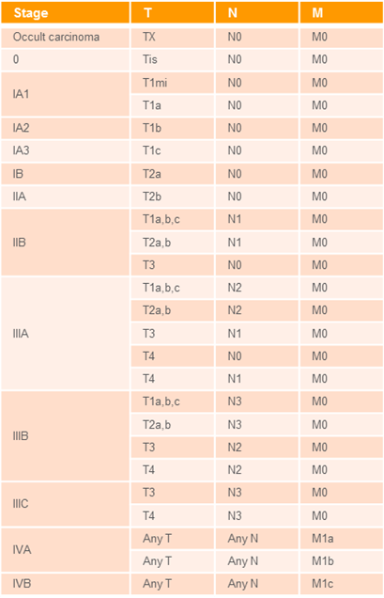
Lung cancer staging and TNM classification¹
The most frequently used system to stage lung cancer is the American Joint Committee on Cancer TNM system, which is based on:
The size and extent of the primary tumor (T)
Whether the cancer has spread to nearby (regional) lymph nodes (N)
Whether the cancer has metastasized (M) to other organs of the body
Once the T, N and M categories have been defined, this information is combined to assign an overall stage of 0, I, II, III or IV
This process is called stage grouping
It produces a range of anatomical stage or prognostic groups (right)
T1mi, minimally invasive adenocarcinoma; Tis, tumor in situ; TNM, tumur, node, metastasis.

Slide 14
Lung cancer TNM classification explained¹
Tumor category | Is assigned when there is:
TX | No information about the T category for the primary tumor, or it is unknown or cannot be assessed (note: use of the TX category should be minimized)
T0 | No evidence of a primary tumor
Tis | Carcinoma in situ (examples of exceptions include: Tis for in situ melanoma of the skin, germ cell neoplasia in situ for testis, and high-grade dysplasia in colorectal carcinoma)
T1, T2, T3, or T4 | Primary invasive tumor, for which a higher category generally means: • An increasing size • An increasing local extension, or • Both
Regional node category | Is assigned when there is:
NX | No information about the N category for the regional lymph nodes, or it is unknown or cannot be assessed (note: use of NX should be minimized)
N0 | No regional lymph node involvement with cancer and for some disease sites, non-nodal regional disease as noted earlier
N1, N2, or N3 | Evidence of regional node(s) containing cancer, with: • an increasing number, and/or • regional nodal group involvement, and/or • size of the nodal metastatic cancer deposit, or • non-nodal regional disease as noted earlier for melanoma and Merkel cell carcinoma, and for colorectal carcinoma
Distant metastasis category* | Is assigned when there is:
M0 | No evidence of distant metastasis
M1 | Distant metastasis
*There is no designation of MX. The absence of any clinical history or physical findings suggestive of metastases in a patient who has not undergone any imaging is sufficient to assign the clinical M0 category. There is no designation of pM0. Biopsy or other pathological information is required to assign the pathological M1 category. Patients with a negative biopsy of a suspected metastatic site are classified as clinical M0 (cM0). cM, clinical metastasis; pM, pathological metastasis; TNM, tumor, node, metastasis.

Slide 15
Summary
Lung cancer is one of the most common cancers, with 2.2 million new cases worldwide in 2020¹
There are two main types of lung cancer: SCLC and NSCLC^{2,3}
NSCLC usually grows and spreads more slowly than SCLC
NSCLC comprises adenocarcinoma and squamous cell carcinoma⁴
Major driver mutations in adenocarcinoma include EGFR and KRAS
The majority of patients with lung cancer have late-stage disease at the time of diagnosis^{5–7}
The TNM system, is used for staging, taking into account the size and extent of the primary tumor (T), whether it has spread via the lymph nodes (N) or metastasized (M)
The 5-year lung cancer survival rate is low in patients with late-stage disease
NSCLC, non-small cell lung cancer; SCLC, small cell lung cancer; TNM, tumor, node, metastasis.

