Slide 1
Real-world evidence
Value, methodological strengths and weaknesses

Slide 2
What is RWE?
Context
RWE is a term for clinical evidence relating to the usage and potential benefits, or risks, of medical products derived from analyses of
real-world data. It can be generated via a range of different study designs, including:¹
Pragmatic trials
Observational studies (prospective or retrospective)
Real-world data
(e.g. electronic medical records, insurance claims data)
Analysed in real-world studies (e.g. retrospective claims review)
Real-world evidence

Slide 3
Growing recognition of RWE within medicine
Context
There has been increasing recognition of the potential value of RWE in recent years as reflected by its increasing presence within the medical literature¹
Year

Slide 4
RWE complements RCT evidence
Context
RWE can:
  Confirm whether RCT results are observed in everyday clinical practice¹
  Provide complementary insights from more varied settings¹
  Help to translate RCT findings into high-quality evidence that can guide routine clinical practice¹
RCTs: required for
regulatory approval
Real-world studies: enable evaluation of:
Tightly controlled patient population
Different populations*
Different treatments
Different
outcomes
Different
settings

Slide 5
Real-world data source example: claims data
Data
RWE data
Healthcare service
(hospital, clinic, pharmacy)
Physical examination
Laboratory procedures
Pharmacy prescriptions
Insurance claim
Data abstraction
Coding
Adjudication
Health database
Privacy protection
Integration
Standardisation
Codes: disease, procedures, drugs
Healthcare/pharmacy encounters

Slide 6
Real-world data source example: EHRs
Data
RWE data
Physician office records
Medical history
Physical examination
Diagnosis
Laboratory results
Prescription information
Hospital admissions
Specialist referrals
Hospital visits (typically outpatient)
Patient enrolled in database

Slide 7
Examples of real-world data sources and the oncology-related questions they can address
Data
RWE data
Research question | Insurance claims | Pragmatic trial | Cancer registries | Chart review | Electronic health records*
Incidence, prevalence
Patient demographics
Cancer diagnosis
Clinical characteristics
Cancer staging
Survival, mortality
Biomarkers, mutations
Laboratory results
Procedures: surgeries, resections, radiation
Disease progression
Treatment duration
Treatment sequencing
Non-oncological comorbidities
Safety events

Slide 8
Real-world data limitations
Data
RWE data
Real-world data source | Examples of potential limitations (not exhaustive)
General | May include off-label use Limited comorbidities/dosing information Other unmeasured confounding factors and/or methodological limitations (selection and assessment bias)
Safety/AE reporting databases | Event reporting is not always mandatory (i.e. true number of events not accurately reflected) New drugs more likely to have AEs reported (‘Weber effect’)^{1,2} Influenced by whether an AE is described in a drug label, publicity about the event/safety concern, class action lawsuits
Claims databases | Health claims codes not well defined, may be inaccurate and without source data verification Outcome definitions not always clear Missing information on comparator treatment can affect outcome interpretation
Observational data from cohort studies | Inconsistent definitions of diagnoses and coding practice (e.g. grading of disease severity) Seldom multi-national
Registries | Often lack comparator arm
Case reports | Small sample size, limited generalisability No comparator Endpoints seldom clearly defined Publication bias results in greater editorial weighting towards difficult cases and/or extreme outcomes (positive or negative)

Slide 9
RCTs vs real-world studies: characteristics
Methods
 | RCT^{1–3} | Real-world studies^{1–3}
Purpose | Achieve regulatory approval | Post-marketing surveillance, cost-effectiveness evaluation, comparative effectiveness, service implementation, centre audit, hypothesis generation
Population characteristics | Predefined, HIGHLY SELECTED population (stringent inclusion/exclusion criteria to assess causality and to minimise potential confounding) | More DIVERSE, ROUTINE CARE patients, including those with characteristics that would prohibit their RCT eligibility (e.g. comorbidities, advanced disease stage)
Intervention or treatment | Randomised treatment allocation; clearly defined, controlled and monitored regimens | Non-randomised regimen; physician judgement as informed by label and other considerations
Comparator (typically) | Placebo or current gold standard | Routinely prescribed treatment alternatives
Outcome | Efficacy, safety | Effectiveness, side-effect profile, patient and clinical behaviours, natural history of disease
Time/observation period | Usually short term | Variable with potential for long-term evaluation
Treatment adherence | Usually high (monitored and reinforced) | Variable, reflecting routine usage

Slide 10
RCTs vs real-world studies: characteristics^{1–4}
Methods
 | RCT | Real-world studies
Accepted by regulatory authorities | Yes | Not routinely*
Internal validity | High | Low
Generalisability/external validity | Low | High
Potential for confounding | Low | High
Maximises potential treatment effect† | Yes | No
Potential to:
Detect rare events | Low | Higher
Evaluate long-term outcomes | Low | High
Evaluate aspects of HCP/patient behaviours | Low | High
Evaluate aspects of healthcare delivery | Low | High

Slide 11
RWE/RCT terminology differences
Methods
Commonly used terminology often differs for real-world studies and RCTs:
RCT | Real-world study
Trial | Study
Allocated treatment | Prescribed treatment
Endpoints | Outcomes
Treatment arm | Treatment group/cohort
Trial results | RWE
Efficacy | Effectiveness
Safety | Side-effect profile
PFS | TTP
PFS, progression-free survival; RCT, randomised controlled trial; RWE, real-world evidence; TTP, time to progression.

Slide 12
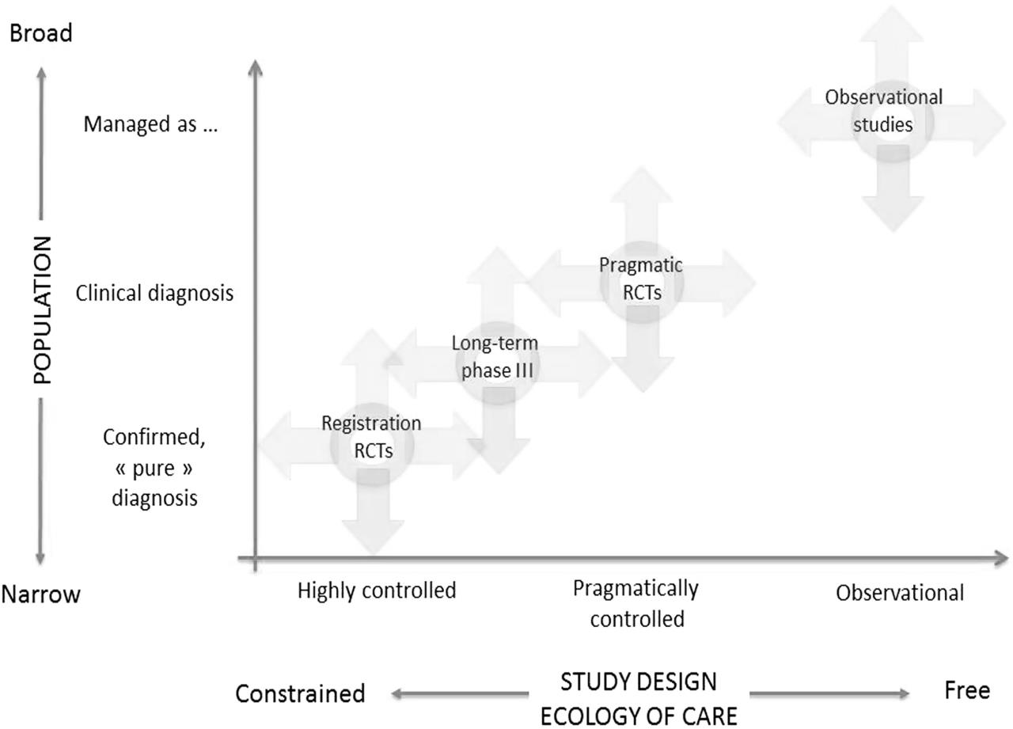
Describing study designs in real-world terms
Methods
Conceptual framework of therapeutic research¹
Broad
The framework links various types of studies based on:
population characteristics and
ecology of care
The typical position of common study designs are illustrated, but can be moved in any direction depending on the specifics of its study design
POPULATION
Narrow
STUDY DESIGN ECOLOGY OF CARE
Constrained
Free

Slide 13
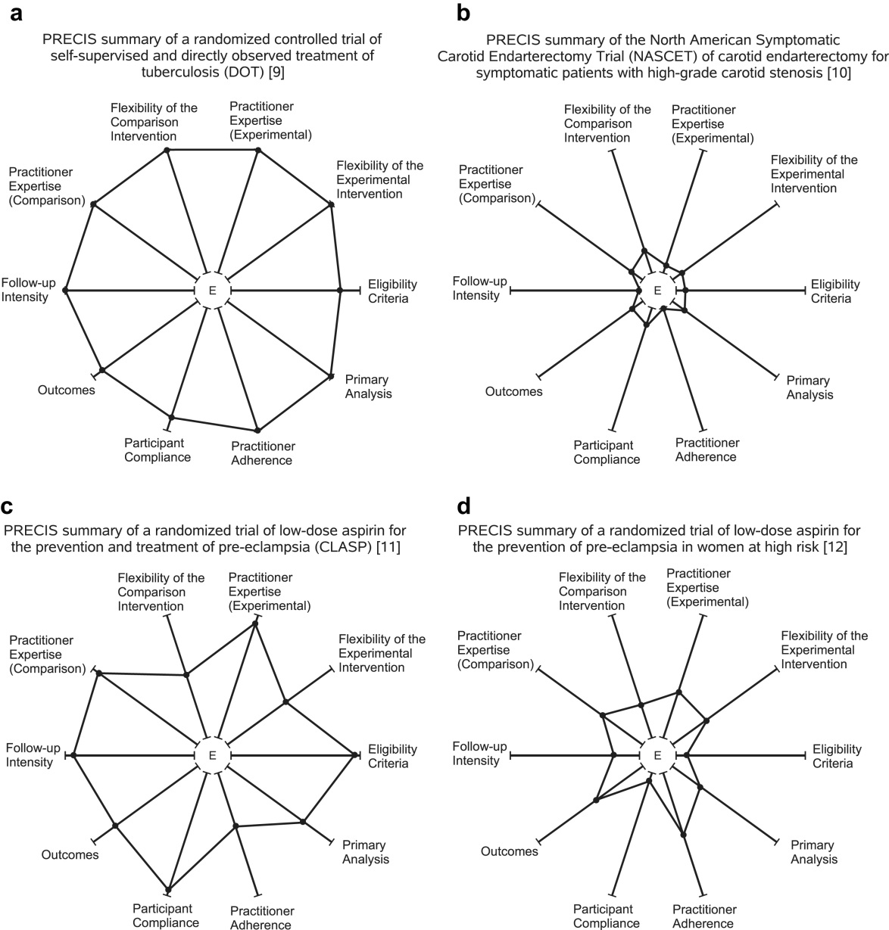
PRECIS wheel: describing study designs using ten explanatory pragmatic axes¹
Methods
  Explanatory studies:
  Tests a causal research hypothesis:
  ‘Does a treatment work under ideal conditions?’
  Pragmatic studies:
  Helps to choose between care options:
  ‘Does a treatment work under usual conditions?’
PRECIS summary providing a visual representation of a ‘narrow’ explanatory study design, e.g. a highly selective RCT involving intensive management and follow-up
PRECIS summary providing a visual representation of a very ‘broad’ pragmatic study design, e.g. a heterogeneous patient population of self-supervised and observed treatment outcomeS

Slide 14
Interpreting RCT findings and RWE
Results
Real-world studies often make use of proxy endpoints if specific variables are not routinely available
RCT endpoints and real-world outcomes can differ; methodological review is required before comparing their findings:
RCT endpoint | Typical RCT definition | Disaggregated components | Challenges of real-world evaluation
PFS | Time from randomisation* until objective tumour progression by RECIST or death | Death PD | Monitoring and follow-up varies across healthcare settings, centres and clinicians, which limits (or prevents) evaluation of RECIST
TTP | Time from randomisation* until clinical progression, or death | Death Clinical progression PD | Routine care methods of assessing and monitoring clinical progression are difficult to standardise for real-world evaluation
TTF | Time from randomisation* to discontinuation for any reason | Death Clinical progression PD AEs** | Pragmatic routine care management approaches may result in treatment through progression resulting in “time on treatment” being used as a proxy for TTF

Slide 15
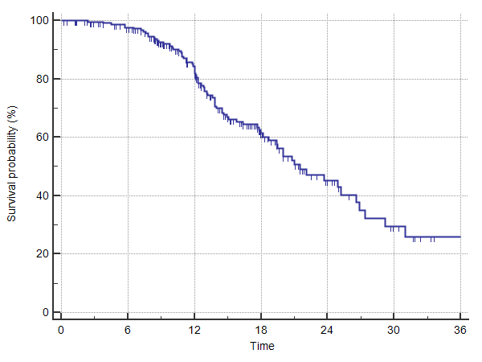
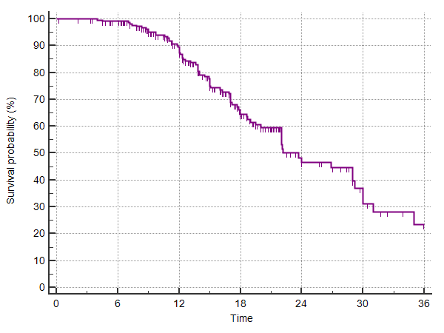
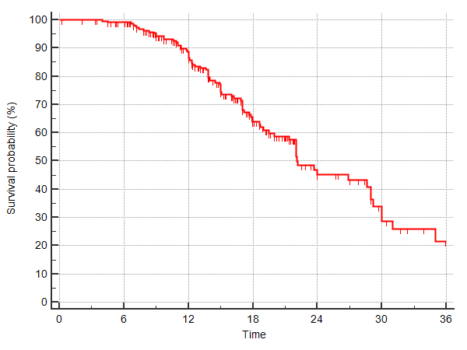
Endpoints – PFS, TTP, TTF: RCT scenario 1
Results
Conceptual scenario: Prolongation of median progression free survival by treatment beyond progression outweighs the effect of treatment discontinuation for other reasons.
Progression-free survival
mPFS: 21.5 months
Contributing events:
Time to progression
TTP: 23.7 months
Contributing events:
Time to treatment failure
TTF: 21.1 months
Contributing events:
PD
Clinical PD
Clinical PD
Clinical PD
AE
AE
Clinical PD
PD
PD
Death
Death
PD
Death
PD
PD
PD
Clinical PD
PD
PD
Clinical PD
AE
PD
AE
PD
PD
AE, adverse events; mPFS, median progression-free survival; RCT, randomised controlled trial; TTF, time to treatment failure; TTP, time to progression.

Slide 16
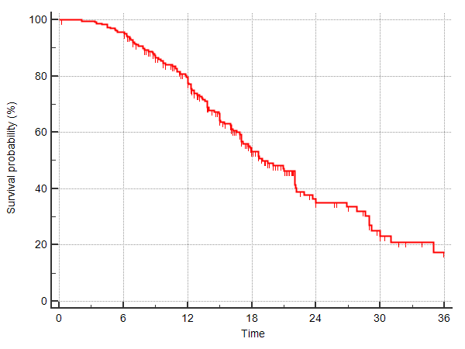
Endpoints – PFS, TTP, TTF: RCT scenario 2
Results
Conceptual scenario: the effect of treatment discontinuation for other reasons has more effect than prolongation of mPFS by treating beyond RECIST progression.
Progression-free survival
mPFS: 21.5 months
Contributing events:
Time to progression
TTP: 23.7 months
Contributing events:
Time to treatment failure
TTF: 19.0 months
Contributing events:
PD
Clinical PD
Clinical PD
AE
Clinical PD
AE
AE
Clinical PD
PD
PD
Death
Death
PD
Death
PD
PD
PD
Clinical PD
PD
PD
Clinical PD
AE
AE
PD
AE
PD
PD
AE, adverse events; mPFS, median progression-free survival; RCT, randomised controlled trial; RECIST, Response Evaluation Criteria in Solid Tumors; TTF, time to treatment failure; TTP, time to progression.

Slide 17
Outcomes – TTP, ToT (TTF/TTD): RW scenario
Results
Conceptual scenario: Routine care patients treated as long as clinician deems beneficial. A greater number of events (e.g. PD, withdrawal, discontinuation due tolerability) contribute to ToT (TTF) analyses, making it shorter than TTP.
Progression-free survival
mPFS: 21.5 months
Contributing events:
Time to progression
TTP: 23.7 months
Contributing events:
Time on treatment /
time to treatment failure
ToT/ TTF: 20.2 months
Contributing events:
Not evaluable: in routine care, patients do not stop according to RECIST and do not have a standardised imaging schedule
Death
PD
Clinical PD
Clinical PD
AE
Clinical PD
AE
AE
Clinical PD
PD
PD
Death
PD
Death
PD
PD
PD
PD
Clinical PD
PD
PD
Clinical PD
AE
AE
PD
AE
PD
AE, adverse events; PD, progressive disease; RECIST, Response Evaluation Criteria in Solid Tumors; RW, real-world; ToT, time on treatment; TTF, time to treatment failure; TTP, time to progression.

Slide 18
Interpreting RWE: comparing vs RCT results
Results
Scenario | Interpretation and considerations
RCT efficacy shown, and real-world effectiveness shown |  | RWE validates RCT findings in routine care patients and/or settings Increases confidence in the finding, e.g. real-world studies of adjuvant chemotherapy have shown OS results comparable with those reported in several pivotal RCTs¹
RCT efficacy shown, but real-world effectiveness not shown |  | Result raises questions about the extent to which a novel therapy can offer benefit in the real world: Does treatment only work in selected populations? Should (particularly toxic) treatment be prescribed in older and/or sicker patients than those who were eligible for the RCT?
RCT efficacy marginal, but real-world effectiveness shown |  | May suggest RCT was underpowered and real-world studies can provide further confirmatory evidence
RCT efficacy not shown, and real-world effectiveness shown | X | The demonstration of real-world effectiveness in the absence of any RCT efficacy signal requires close statistical scrutiny to assess potential sources of bias

Slide 19
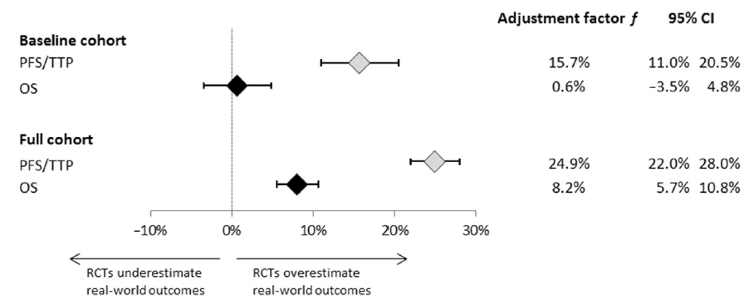
Side-by-side comparison: real-world effectiveness vs RCT efficacy
Results
Predicting Real-World Effectiveness of Cancer Therapies Using Overall Survival and Progression-Free Survival from Clinical Trials: Empirical Evidence for the ASCO Value Framework' missing ¹
Objective:
Measure the relationship between RCT efficacy and real-world effectiveness for oncology treatments, in:
  Selected real-world patients who meet routine RCT eligibility criteria (Baseline cohort)
  All real-world patients with evaluable records (Full cohort)
  Methods:
RCT data: abstracted from 21 Phase III oncology RCTs reporting OS or PFS or TTP
RW data: EHRs – SEERs Medicare data
Primary outcome: real-world OS, estimated as MHR
Cox proportional hazard regression model used to calibrate difference between RW MHR and:
  RCT MHR
  RCT PPS/TTP SHR
  Results:
Example data:*
Baseline cohort = trial-eligible real-world patients
RCT |  |  | Real world
OS: MHR | 0.80 | → | OS: MHR | 0.80
PFS: SHR | 0.80 | → | OS: MHR | 0.93
Full cohort: unselected routine care population
RCT |  |  | Real world
OS: MHR | 0.80 | → | OS: MHR | 0.86
PFS: SHR | 0.80 | → | OS: MHR | 1.00
  Author conclusions:
Baseline cohort: in real-world patients eligible for RCTs, real-world OS benefits were:
  Similar to those observed in RCTs based on OS endpoints
  16% less than RCTs based on surrogate endpoints (PFS, TTP)
Full cohort: in non-selected real-world populations, treatment benefit was predicted to be even less than in the baseline, RCT-eligible real-world cohort
*Not reported in Ladawalla et al; included for illustrative purposes to exemplify the direction of the observed differences.
EHR, electronic health record; HR, hazard ratio; MHR, mortality hazard ratio; OS, overall survival; PFS, progression-free survival; RCT, randomised controlled trial; SEERS, Surveillance and Epidemiology End Results; SHR, surrogate hazard ratio; TTP, time to progression.
1. Lakdawalla DN, et al. Value in Health 2017;20(7):866–75

Slide 20
Pragmatic real-world endpoints in NSCLC studies: considerations
Results
Analysis of time-to-treatment discontinuation of targeted therapy, immunotherapy, and chemotherapy in clinical trials of patients with non-small-cell lung cancer¹
Methods:
18 metastatic NSCLC RCTs:
  Initiated after 2007
  Submitted to the FDA
  Involved 8947 patients
Compared TTD to PFS and OS
  TTD: defined as date of randomisation
  to date of discontinuation or death
Results:
Overall: TTD was more closely associated with
PFS (r=0.87, 95% CI 0.86–0.87) than with
OS (r=0.68, 95% CI 0.67–0.69)
Oncogene-targeted subgroups: mTTDs exceeded mPFS:
  EGFR+: 13.4 months vs 11.4 months, respectively
  ALK+: 14.1 months vs 11.3 months, respectively
Results (cont’d):
A
PFS ChT double + maint.
B
PFS ChT (no maint.)
C
PFS EGFR TKI Arm 1
D
PFS ChT monotherapy
PFS EGFR TKI
PFS EGFR TKI
PFS EGFR TKI Arm 2
PFS ICI
TTD ChT double + maint.
TTD ChT (no maint.)
TTD EGFT TKI Arm 1
TTD Cht monotherapy
TTD EGFR TKI
TTD EGFR TKI
TTD EGFT TKI Arm 2
TTD ICI
Survival probability (%)
Survival probability (%)
Survival probability (%)
Survival probability (%)
Time (months)
Time (months)
Time (months)
Time (months)
Selected KM analysis of TTD and PFS: (A) EGFR TKI vs doublet ChT with maintenance EGFR mutant population; (B) EGFR TKI vs doublet ChT (no maintenance) in EGFR mutant population; (C) EGFR TKI vs EGFR TKI in EGFR mutant population; (D) ICI vs monotherapy ChT
Author conclusions:
mTTD exceeds mPFS for oncogene-targeted subgroups due to treatment beyond RECIST progression. The ability to treat beyond progression may reflect real-world treatment tolerability
With ICI therapy, mPFS (4.2 months) was slightly longer than mTTD (3.5 months), with cases of both early and late TTD. This may reflect some: cases of early termination due to immune-mediated AEs; some instances of durable treaetment benefit, and others of treatment beyond conventional progression
Further research is needed to validate TTD as a measure for pragmatic RCTs

Slide 21
RWE Summary
Background:
  Real-world studies complement RCTs – they provide evidence from everyday patient populations managed in routine care settings, including those with characteristics that would preclude their participation in RCTs^{1–3}
Real-world data sources:
  There is a wider range of real-world data sources available; each has specific strengths and limitations
  Real-world data source examples include: electronic medical record databases (primary care ± secondary care ± pharmacy ± other linked data); insurance claims databases; patient access schemes; registries
Real-world studies vs RCTs:^{1,3}
  Conducted for different purposes, e.g. drug registration (RCTs) vs long-term surveillance (real-world studies)
  Differ according to how much their design reflects (i) real-world patients and (ii) real-world clinical management
  Different strengths and weaknesses, e.g. real-world studies offer high external validity, but low internal validity
Real-world vs RCT findings:
  Often evaluate different outcomes; real-world studies make use of proxy measures where specific variables are unavailable
  RCTs may over-estimate treatment benefits through their selection of ‘ideal’ populations⁴
  Real-world studies and RCTs provide complementary evidence; a judicious approach combining evidence from both
  can provide a more complete view of the evidence base^{1–5}

