Slide 1
Immuno-oncology: immunomodulation and checkpoint inhibition

Slide 2
Introduction
Cancer immunotherapy aims to generate or augment an immune response, unlike conventional treatments that directly target features of cancer cell growth such as survival, proliferation or metabolism¹
Checkpoint inhibition is a form of immunomodulation that uses monoclonal antibodies to block inhibitory receptors on T cells and promote T cell activation, and is of considerable therapeutic interest¹
Targeting the immune system in this way is associated with a robust response that has the potential to stimulate persistent tumour regression mediated by immunological memory^{1,2}
A number of different strategies are under investigation to optimise outcomes with immunotherapeutic agents

Slide 3
Targeting immune checkpoint pathways in cancer

Slide 4
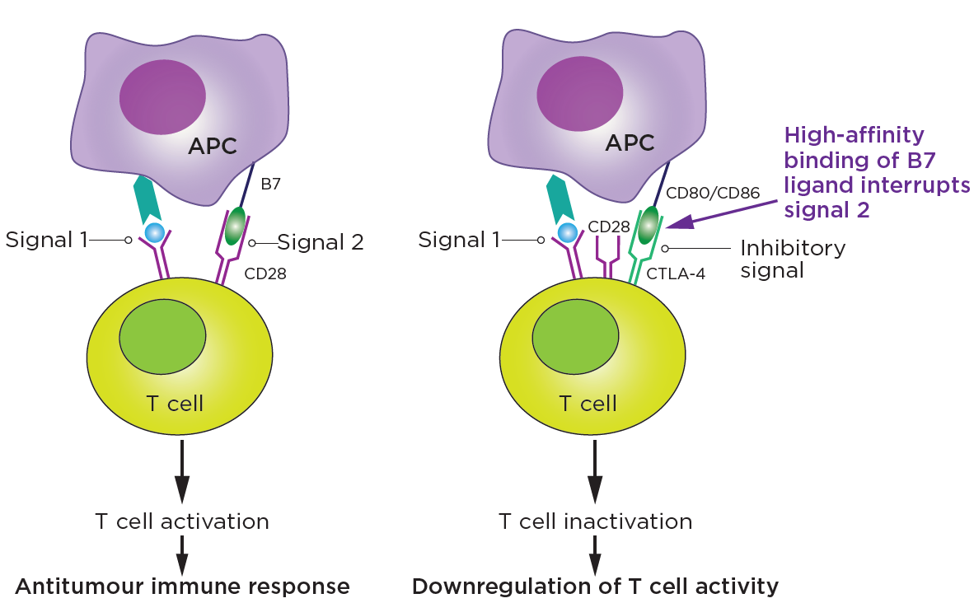
Tumour cells suppress the antitumour immune response by inactivating T cells
T cell activation in response to tumour antigens is a complex process involving two independent pathways¹
Signal 1: MHC-mediated T cell receptor signalling in response to antigen stimulation
Signal 2: costimulation of the CD28 receptor by B7 ligands on APCs
Activated T cells drive cytotoxic cell-mediated immunity, augment antibody responses and engage accessory cells such as macrophages²
The activity of T cells is limited by inhibitory receptors, which downregulate signal 2 to maintain immune homeostasis and prevent autoimmunity³
Tumours evade T cell immunosurveillance by activating inhibitory receptors, resulting in T cell apoptosis and depletion⁴
Inhibitory receptors downregulate T cell activity⁵
APC, antigen-presenting cell; CD, cluster of differentiation; CTLA-4, cytotoxic T-lymphocyte-associated protein; MHC, major histocompatibility complex. Figure adapted from Sharma A, et al. 2019.⁵

Slide 5
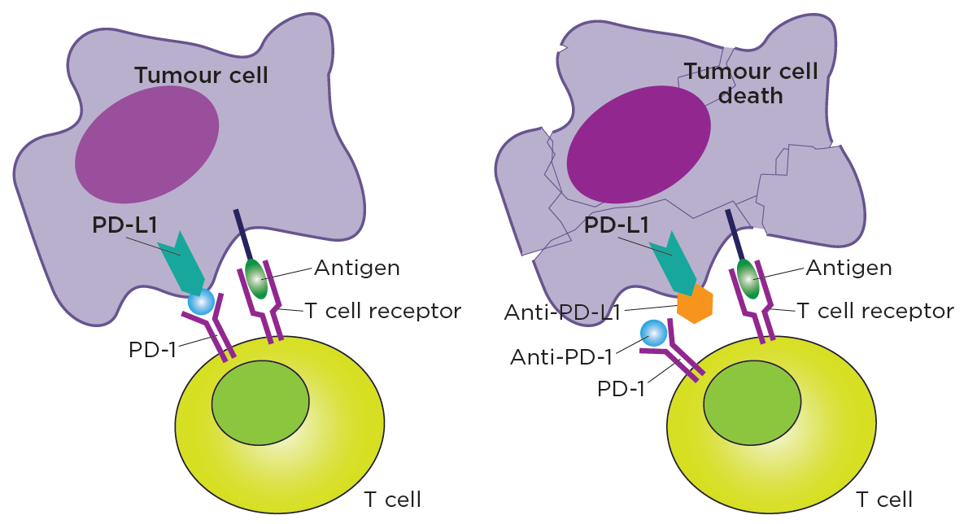
Targeting lymphoid immune cells has been shown to elicit an antitumour response
Immune modulation targets immune cells rather than cancer cells to inhibit tumour progression¹
Immune modulation with ICIs upregulates the immune response by blocking inhibitory receptors^{1,2}
Inhibitory immune checkpoints include PD-1, CTLA-4, LAG-3, TIGIT and TIM-3, among others^{1,2}
Checkpoint inhibition is not necessarily specific to any cancer type, as shown by the approval of ICIs across a range of cancer types^{1,4}
Upregulating the immune response with checkpoint inhibitors⁵
Binding of PD-L1 antigen to PD-1 blocks T cell mediated killing of cancer cell
Blocking PD-1 or PD-L1 reinvigorates the T cell response
APC, antigen-presenting cell; CTLA-4, cytotoxic T-lymphocyte-associated protein 4, ICI, immune checkpoint inhibitor; LAG-3, lymphocyte-activation gene 3; PD-1, programmed cell death protein 1; PD-L1, programmed cell death-ligand 1; TIGIT, T cell immunoreceptor with Ig and ITIM domains; TIM-3, T cell immunoglobulin and mucin-domain containing-3. Figure adapted from PDQ Cancer Information Summaries. 2002.⁵

Slide 6
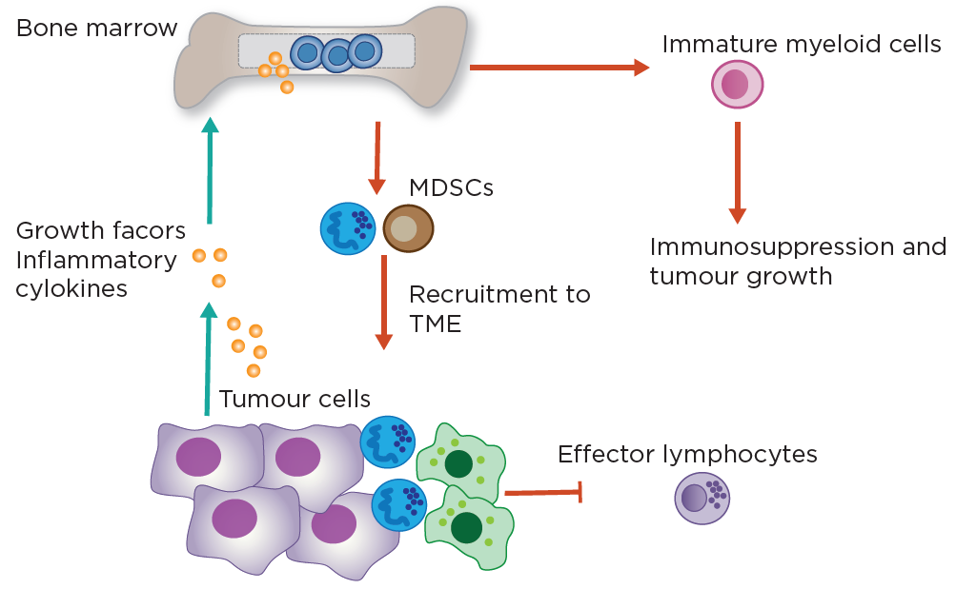
Inhibitory receptors on myeloid cells are also of interest as therapeutic targets
Cancer-associated inflammation upregulates production of immunosuppressive myeloid cells including MDSCs and TAMs¹
MDSCs suppress effector T cells and NK cells, and express high levels of PD-L1²
The potent immunosuppressive effect of myeloid immune cells is a major barrier to cancer immunotherapy¹
This has generated interest in ICIs that target myeloid immune cells, and combination treatments with other myeloid and/or lymphoid modulators^{1,2}
Cancer-associated inflammation drives
myeloid immunosuppression¹
ICI, immune checkpoint inhibitor; MDSC, myeloid-derived suppressor cell; NK, natural killer; PD-L1, programmed cell death-ligand 1; TAM, tumour-associated macrophage; TME, tumour microenvironment. Figure adapted from Nakamura K, et al. 2019.¹

Slide 7
In recent years, ICIs have emerged as front-line treatment for a range of different cancer types
A number of different ICIs have been approved as first- and later-line options in a wide range of cancer types, including metastatic melanoma, non-small cell lung cancer, renal cell carcinoma and bladder/urothelial cancer¹⁻⁵
CTLA-4, cytotoxic T-lymphocyte-associated protein 4, ICI, immune checkpoint inhibitor; PD-1, programmed cell death protein 1; PD-L1, programmed cell death-ligand 1.

Slide 8
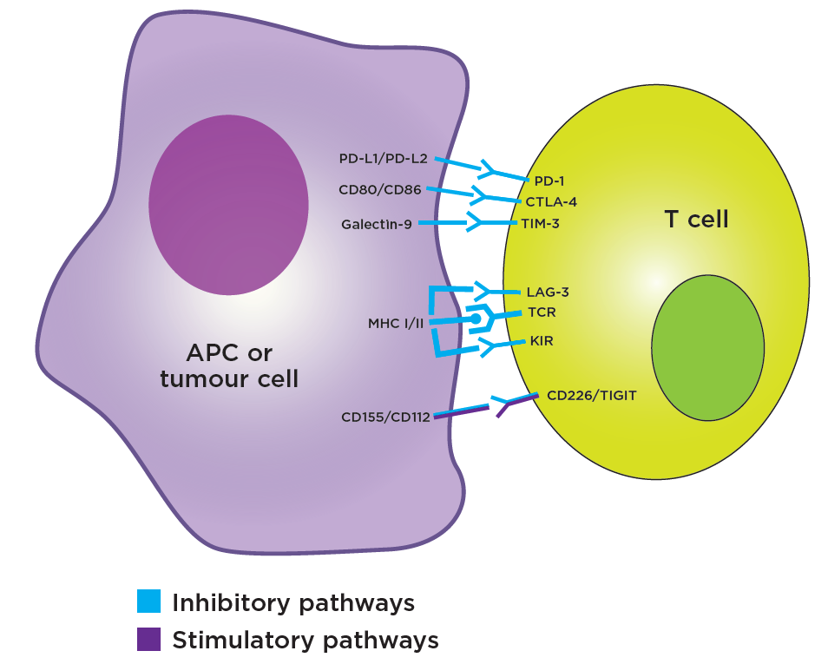
Dual targeting of different inhibitory pathways may augment treatment outcomes with ICIs
Primary and acquired treatment resistance limit the effectiveness of ICI monotherapy¹
The synergistic effect of targeting different immune inhibitory pathways has the potential to overcome resistance and improve outcomes¹
The therapeutic potential of ICI combinations has been validated by the approval of the anti-CTLA-4/anti-PD-1 combination regimen in a range of different indications²
Immune interactions between APCs or tumour cells and T cells³
APC, antigen-presenting cell; CD, cluster of differentiation; CTLA-4, cytotoxic T-lymphocyte-associated protein 4; ICI, immune checkpoint inhibitor; KIR, killer Ig-like receptors; LAG-3, lymphocyte-activation gene 3; MHC, major histocompatibility complex; PD-1, programmed cell death protein 1; PD-L1/2, programmed cell death-ligand 1/2; TIGIT, T cell immunoreceptor with Ig and ITIM domains; T cell immunoreceptor with Ig and ITIM domains; TIM-3, T cell immunoglobulin and mucin-domain containing-3; TME, tumour microenvironment. Figure adapted from Marin-Acevedo JA, et al. 2018.³

Slide 9
ICIs in combination with cancer cell-directed therapies may also have synergistic potential
Cancer cells use many pathways to sustain growth, replicate and resist cell death¹
Combining ICIs with cancer cell-directed therapies has the potential to augment the antitumor effect through discrete targeting^{2,3}
Inhibition of the Wnt/β-catenin pathway may improve outcomes with checkpoint inhibitors by improving T-cell infiltration and priming³
p53-targeted agents may augment outcomes by sensitizing tumors to ICIs⁴
Cancer hallmarks
Potential targets
Activation of cancer cell signaling
KRAS
ErbB
Evading cell death (including immunogenic cell death)
Cell death pathways
p53
ICI, immune checkpoint inhibitor; KRAS, Kirsten Rat Sarcoma; MYC, MYC proto-oncogene, basic helix-loop-helix transcription factor.

Slide 10
Combinations of ICIs with novel targets

Slide 11
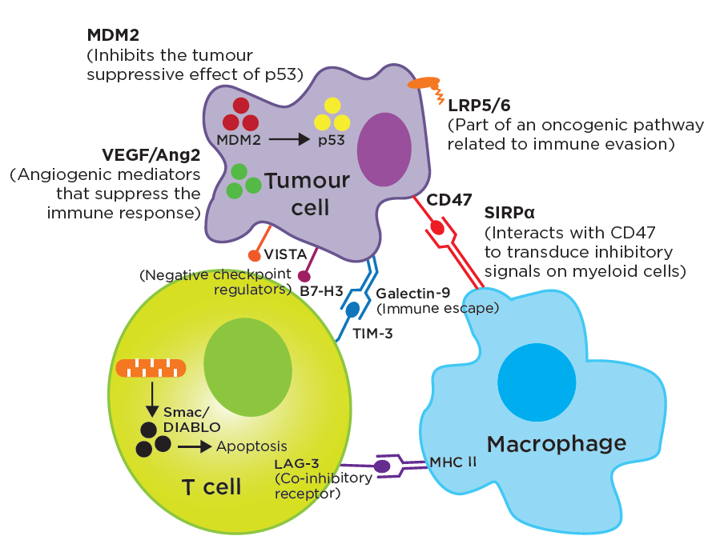
Novel lymphoid and myeloid checkpoint-related agents could improve outcomes with approved immunotherapies
The TME promotes T cell impairment and immune escape¹
Novel targets in the lymphoid and myeloid TME are being explored in combination with anti-CTLA-4 and anti-PD-1/PD-L1 agents¹
Combinations with novel targets have the potential to counteract immune escape with acceptable toxicity profiles¹
Examples of novel lymphoid and myeloid targets in the TME¹⁻³
AE, adverse event; Ang 2, angiopoietin−2; CD47, cluster of differentiation 47; CTLA-4, cytotoxic T-lymphocyte-associated protein 4; DIABLO, direct inhibitor of apoptosis-binding protein with low pI; ICI, immune checkpoint inhibitors; LAG-3, lymphocyte-activation gene 3; LRP, low density lipoprotein receptor-related protein; MDM2, mouse double minute 2 homolog; PD-L1, programmed cell death ligand; SIRPα, signal regulatory protein-α; Smac, second mitochondria-derived activator of caspase; TIGIT, T cell immunoreceptor with Ig and ITIM domains; TIM-3, T cell immunoglobulin and mucin-domain containing-3; TME, tumour microenvironment; VEGF, vascular endothelial growth factor.
Figure adapted from Khair DO, et al. 2019.

Slide 12
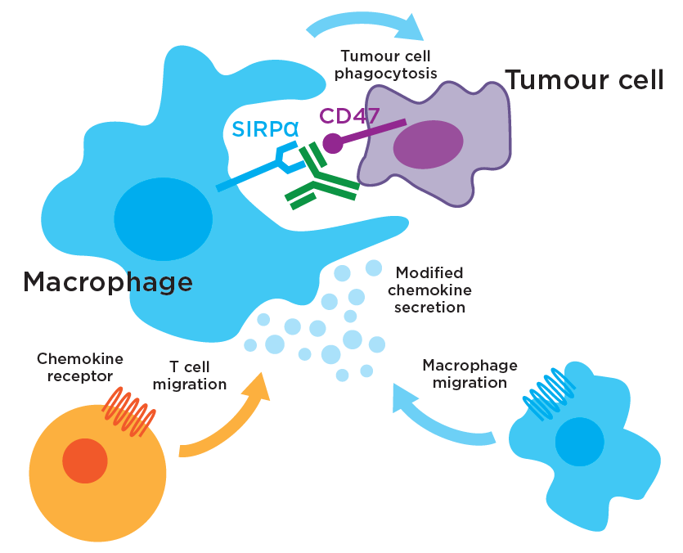
SIRPα inhibition may have a synergistic antitumour effect when combined with ICIs
Infiltrating myeloid cells promote immune evasion, and this has generated interest in myeloid-immune targets^{1,2}
The CD47–SIRPα interaction transduces inhibitory signals on macrophages and other myeloid cells²
Preclinical studies have indicated that CD47 or SIRPα blockade in combination with ICIs may have a synergistic antitumour effect³
The use of SIRPα antagonists to enhance antitumour immunity is currently being explored⁴
CD, cluster of differentiation; ICI, immune checkpoint inhibitor; SIRPα, signal regulatory protein-α.

Slide 13
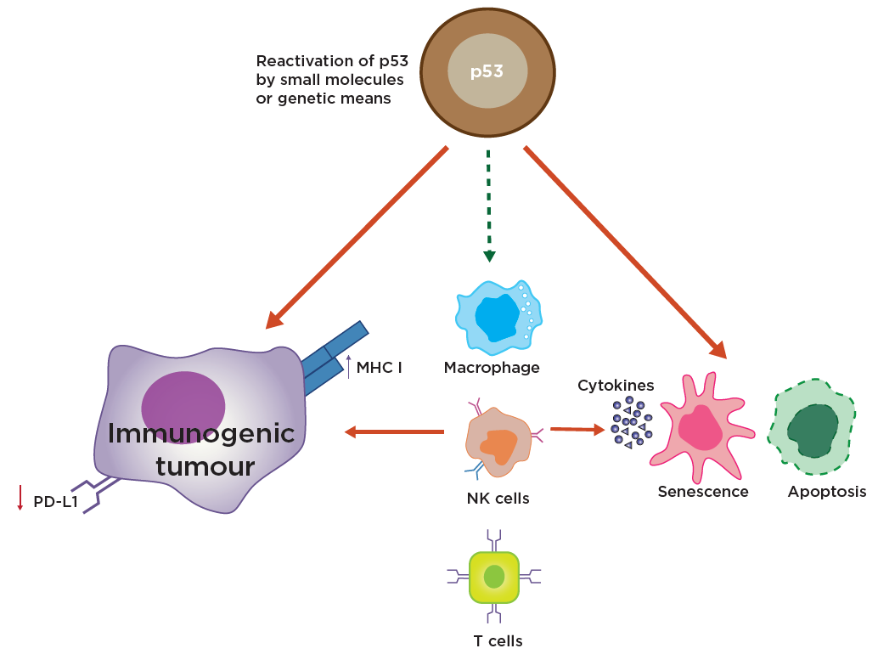
Combining ICIs with p53-targeted therapy may augment the innate and adaptive immune response to cancer
MDM2 inhibits the tumour suppressor p53, which is critical for regulating genes involved in DNA repair, senescence and apoptosis¹
When amplified, MDM2 facilitates p53 degradation, promoting the development and maintenance of many cancers¹
Reactivation of p53 can promote innate and adaptive immunity, and decrease expression of PD-L1²
The cytotoxic potential of a PD-1 inhibitor in combination with p53-targeted therapy is currently being explored in clinical trials³
p53 promotes senescence and apoptosis, and the release of cytokines from senescent cells activates immune cells²
ICI, immune checkpoint inhibitor; MDM2, mouse double minute 2 homolog; MHC, major histocompatibility complex; NK, natural killer; PD-1, programmed cell death protein 1; PD-L1, programmed cell death-ligand 1. Figure adapted from Sanz G, et al. 2019.²

Slide 14
Summary

Slide 15
Summary
Immune modulation aims to control tumour growth and progression by targeting immune cells, and it is therefore different to traditional cancer chemotherapy, which targets cancer cells directly¹
ICIs are a form of immune modulation that augment the antitumour immune response by interrupting co-inhibitory signalling pathways that enable cancer cells to evade immune surveillance²
ICIs have emerged as first-line treatment options for a range of different cancer types, including metastatic melanoma, non-small cell lung cancer, renal cell carcinoma and bladder/urothelial cancer³
Dual ICI combination treatment has the potential to improve treatment outcomes, and has been validated by the approval of combined anti-CTLA-4/anti-PD-1 regimens in specific cancer types⁴
The benefits of combining ICI inhibitors with novel checkpoint-related molecules and other agents that target cancer growth pathways are being explored⁵
CTLA-4, cytotoxic T-lymphocyte-associated protein 4; ICI, immune checkpoint inhibitor; PD-1, programmed cell death protein 1.

